Slide 1
Strategic Planning
Clinical Epidemiology & Biostatistic Unit

Slide 2
Introduction
The existence of CE&BU is based on the assignment letter issued jointly by the Dean Faculty of Medicine, UGM and the Director of Dr. Sardjito hospital. Both Faculty of Medicine, UGM and Dr. Sardjito hospital have constantly give full support to CE & BU in conducting its educational and research activities
The CE&BU was established in the early 1980s to improve the quality of health care, medical education and research, and public health policy in developing countries. CE&BU became a member of the International Clinical Epidemiology Network (INCLEN), of which the CE&BU Faculty of Medicine UGM is the sole Indonesian member of INCLEN at that time.
CE&BU has achieved an outstanding level in education and research activities. The CE&BU has been conducting master degree for clinical epidemiology since 1992 with the students from Indonesia and abroad (China, Philippine, Thailand, Vietnam, Irak). The recognition in research activities can be shown by the large number of research studies from CE&BU, and the appointment of CE&BU as the only Clinical Epidemiology Research and Training Center (CERTC) in Indonesia for ASEAN.

Slide 3
Basic Value
Clinical Epidemiology and Biostatistics Unit, Faculty of Medicine, Gadjah Mada University has core values include:
Integrity, excellence, leadership, diversity, inclusion, collaboration, respect, innovation and mentoring

Slide 4
Vision
Clinical Epidemiology and Biostatistics Unit, Faculty of Medicine, Gadjah Mada University has vision to become
an excellent institution in Indonesia on education and clinical research and promote evidence based medicine to improve health care services and health policy in Indonesia

Slide 5
Mision
Clinical Epidemiology and Biostatistics Unit, Faculty of Medicine, Gadjah Mada University has mission
To contibute the multi disciplinary approach (clinical epidemiology, biostatistics, clinical and health economics, and social science) in solving priority health problems in the clinical and community settings
To serve as a main resource to facilitate teaching, learning, and consultations in applied clinical and health research, and health care evaluation based on clinical epidemiology approach in Indonesia

Slide 6
Commitment
Clinical Epidemiology and Biostatistics Unit, Faculty of Medicine, Gadjah Mada University is committed to
Conduct training and clinical research to promote evidence based practice

Slide 7
Objectives
To serve as acenter of excellence for epidemiological research within academic health system in Faculty of Medicine UGM and Sardjito hospital by conducting research that are relevant to local, national and regional health care issues.
To create an educational environment in support of collaborative epidemiological research, including training in methods of research design, biostatistics, and data processing; as well as to provide experience working with administrative databases and electronic medical registries as sources of data for research.
To support undergraduate and postgraduate programs on training evidence-based medicine and research, and provides assistance and consultancy for health research

Slide 8
SWOT Analysis
STRENGTH
Faculty members have higher competences and advanced degrees in various disciplines on clinical research and evidence based medicine including clinicians, pharmacologist, biostatisticians, social sciences, public health, pharmacist, nurses, nutrition, and health policy

Slide 9
SWOT Analysis
WEAKNESS
As a center/unit the researchers do not have tenure track or career ladder and the majority of members focus on leading their own research and are in the tenure track on their department.
Limited interhospitals collaboration in clincal research

Slide 10
SWOT Analysis
Opportunity
Increasing the needs of professionals, researchers and health workers for training in clinical research, health technology assessment and evidence based medicine.
Increasing the need of clinical studies, clinical trials and research data

Slide 11
SWOT Analysis
THREAT
Support staff has limited management skill
Faculty members have limited time to support activities within the centre

Slide 12
Strategic Policy
Involving human resources from inter-department within Faculty of Medicine and Hospitals in research and education
Optimizing research and education/training activities related to clinical epidemiology, evidence based medicine, HTA, systematic review, CDM, and data management
Conducting research collaboration (local, national or international)

Slide 13
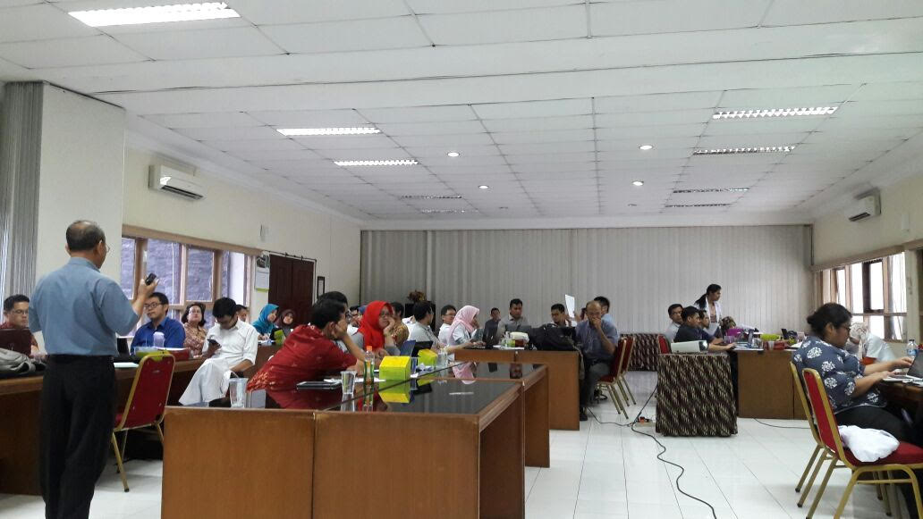
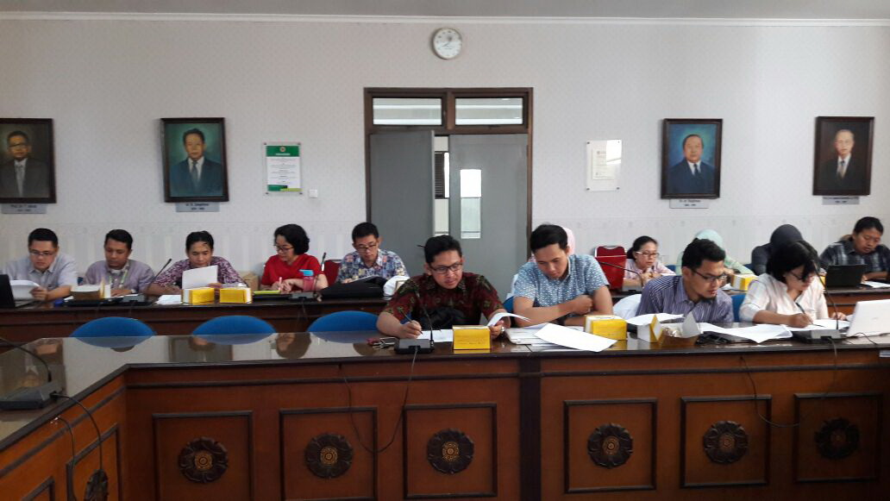
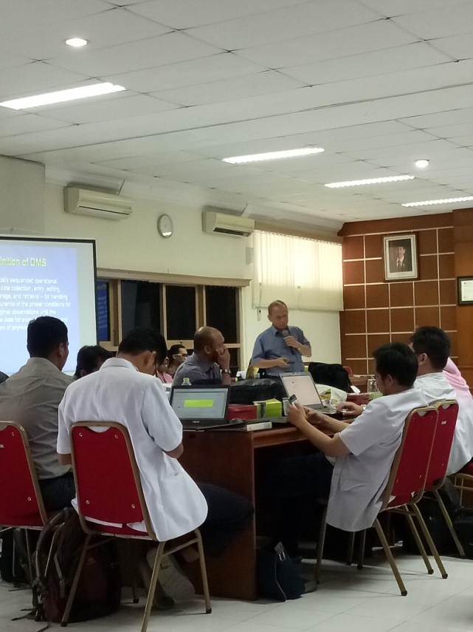
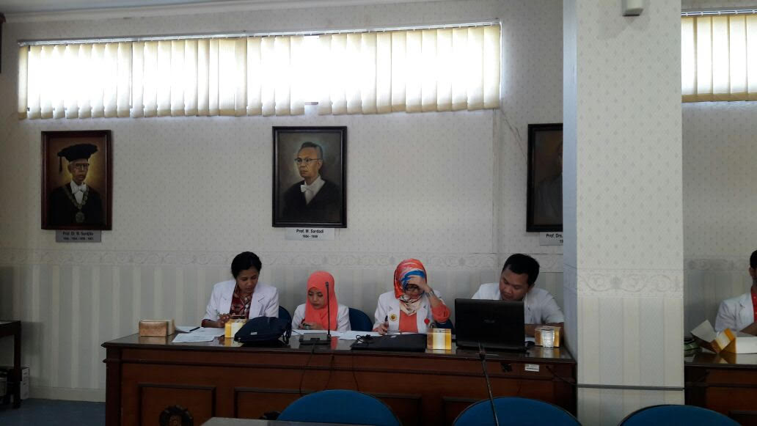
Activities 2017
Research methodology & biostatistics training for residents & Dept Anesthesiology

Slide 14
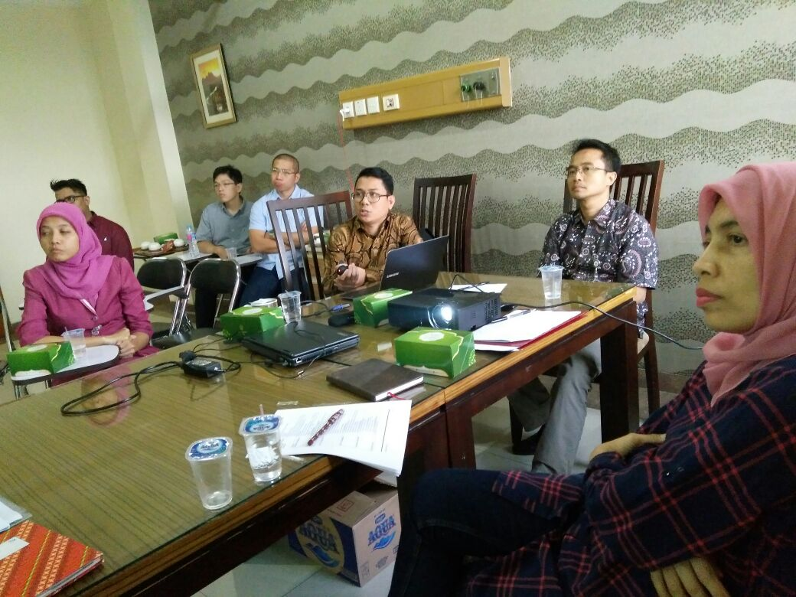
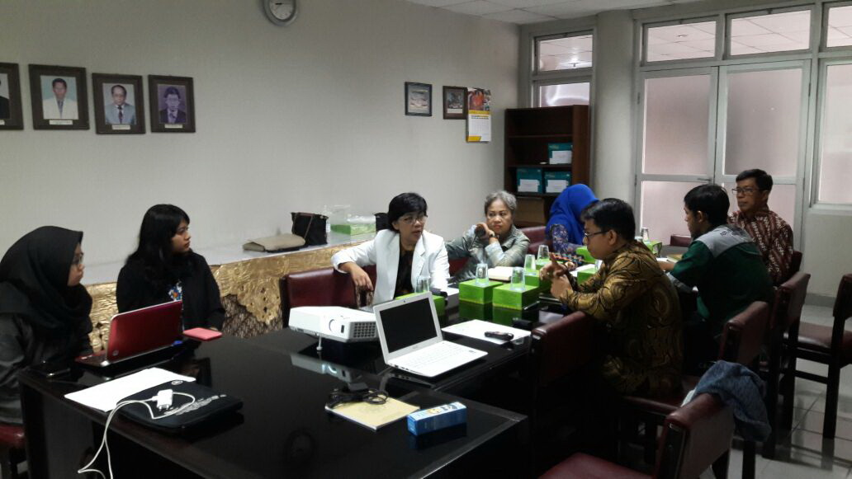
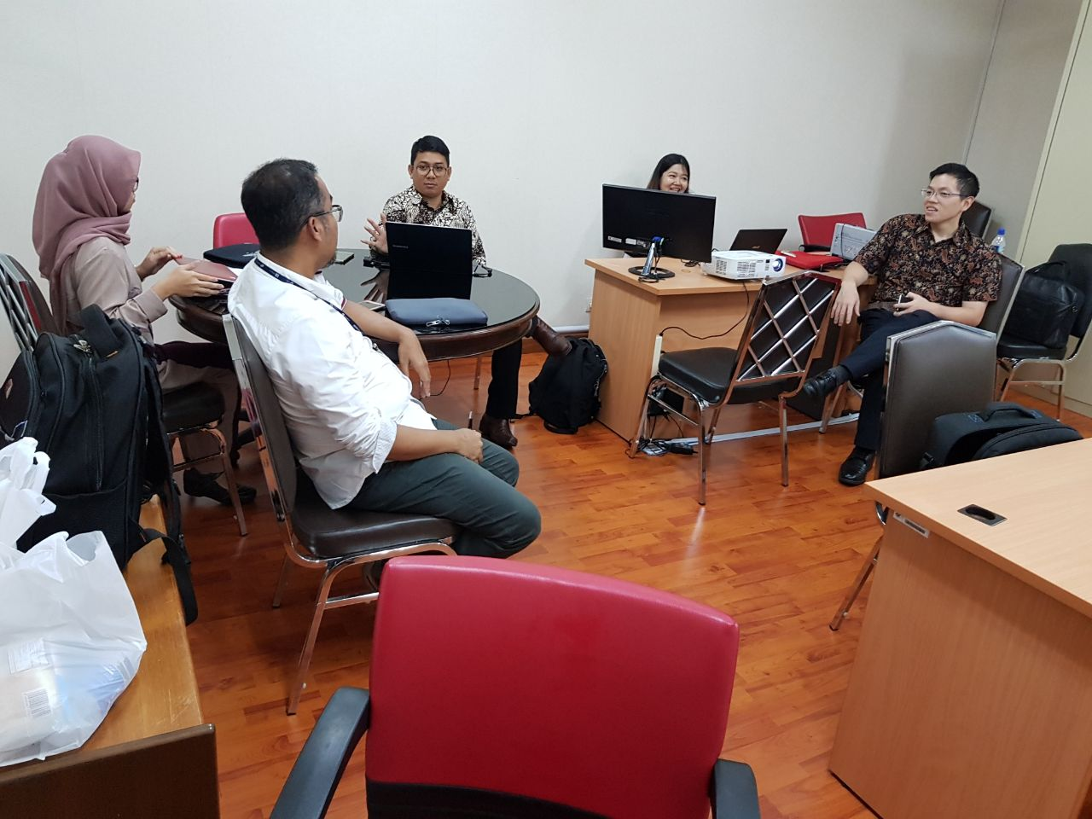
Activities 2017
Clinical Study : Cost Effectiveness Ticagrelor in Acute Coronary Syndrome
Harapan Kita Hospital
Sardjito Hospital
Bina Waluya Hospital

Slide 15
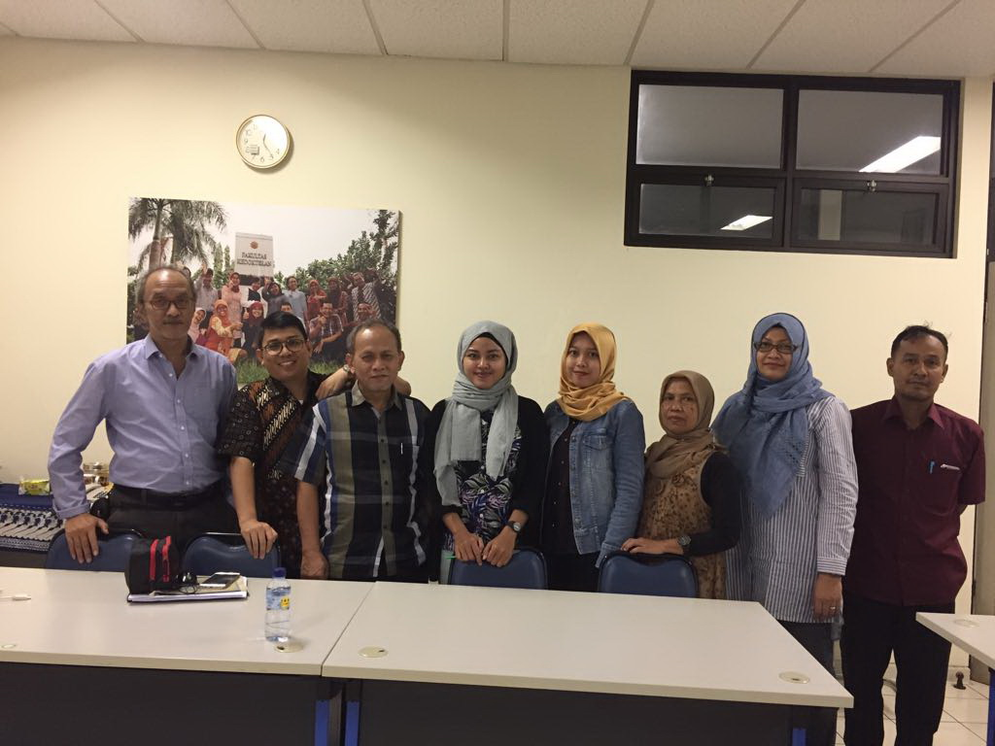
Activities 2017
Clinical Study : Post Marketing Surveillance (PMS) Pethidin & levosol

Slide 16
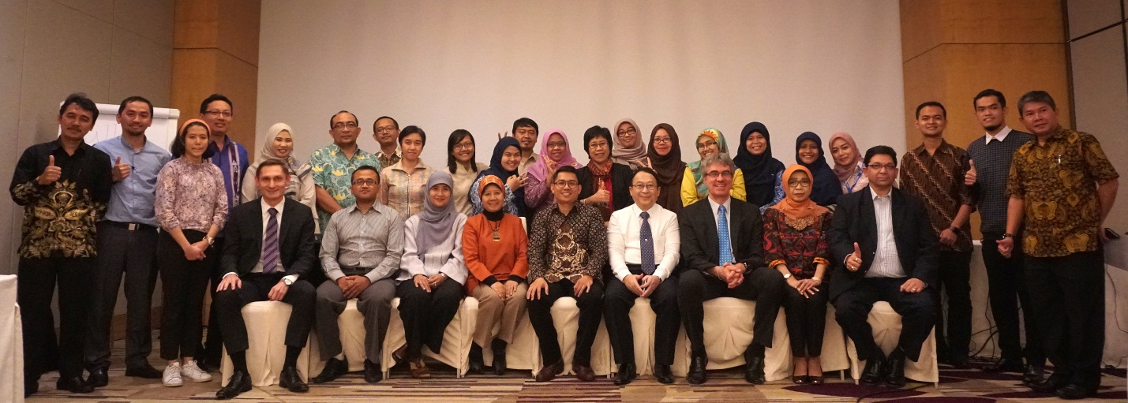
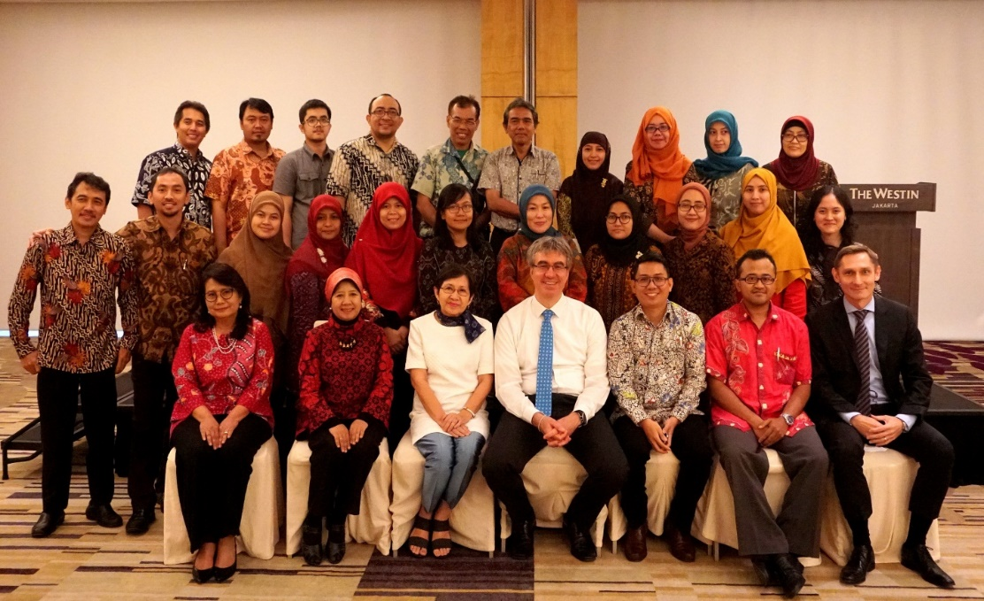
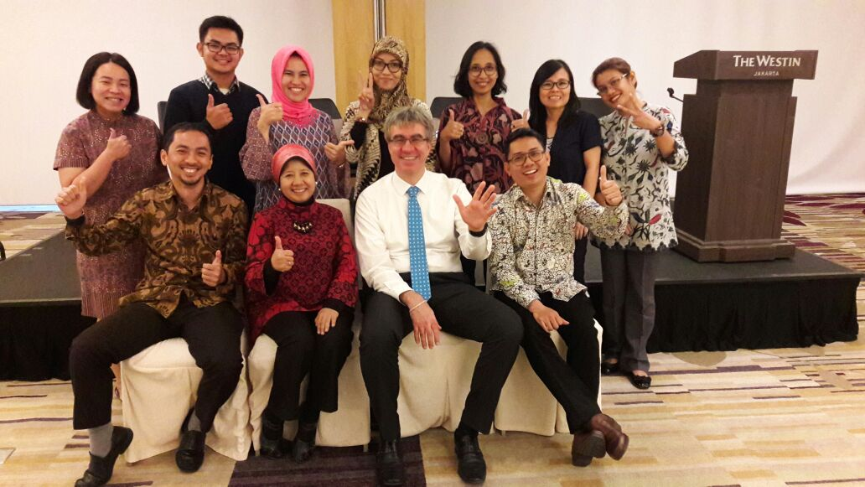
Activities 2017
Health Technology Assessment – International Training & Workshop – collaboration with KPMAK

Slide 17
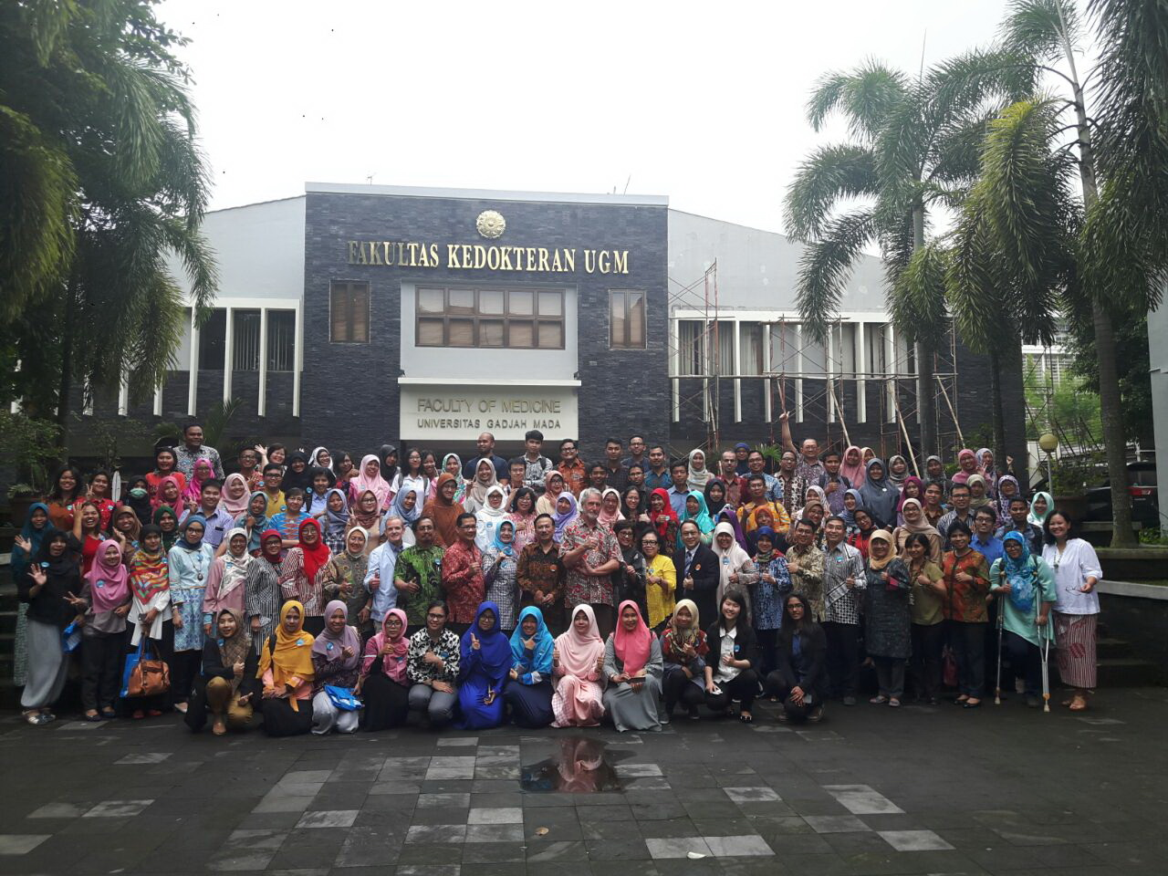
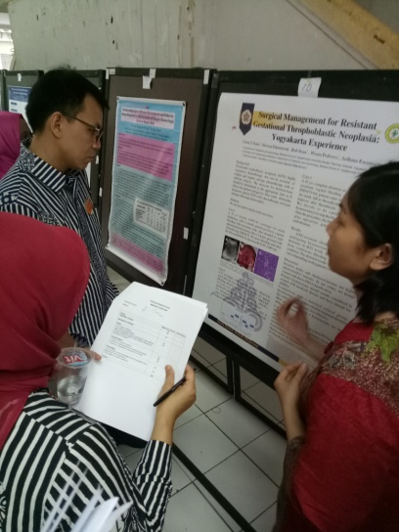
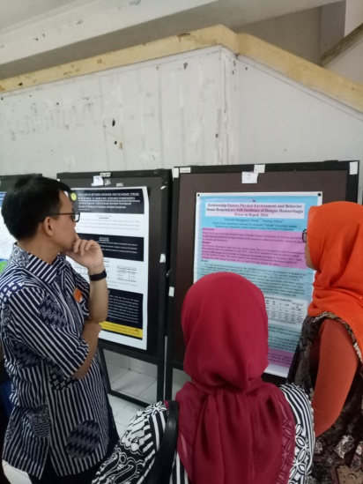
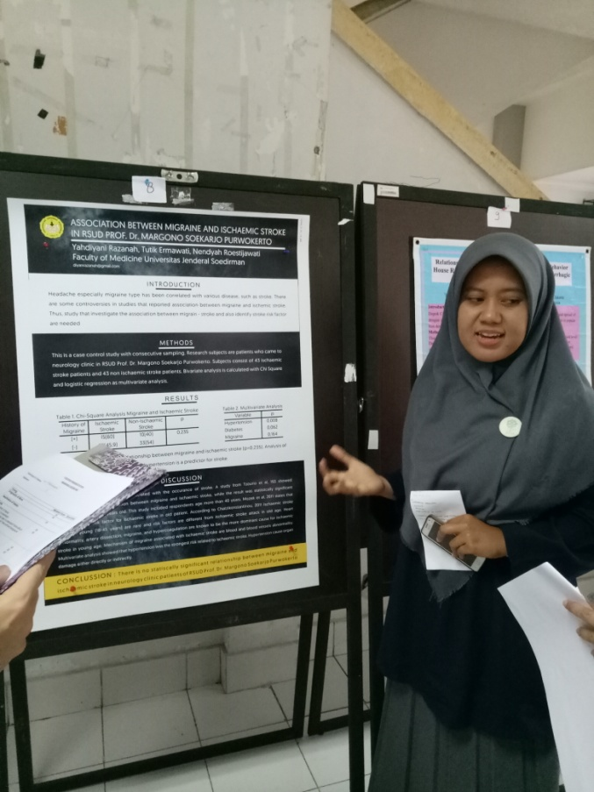
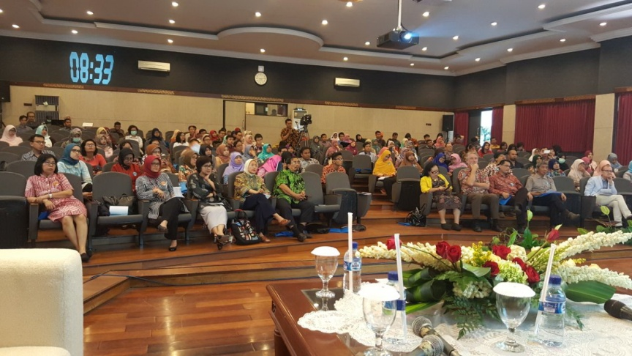
Activities 2017
International Clinical Epidemiology Conference – collaboration with ICE-EBM

Slide 18
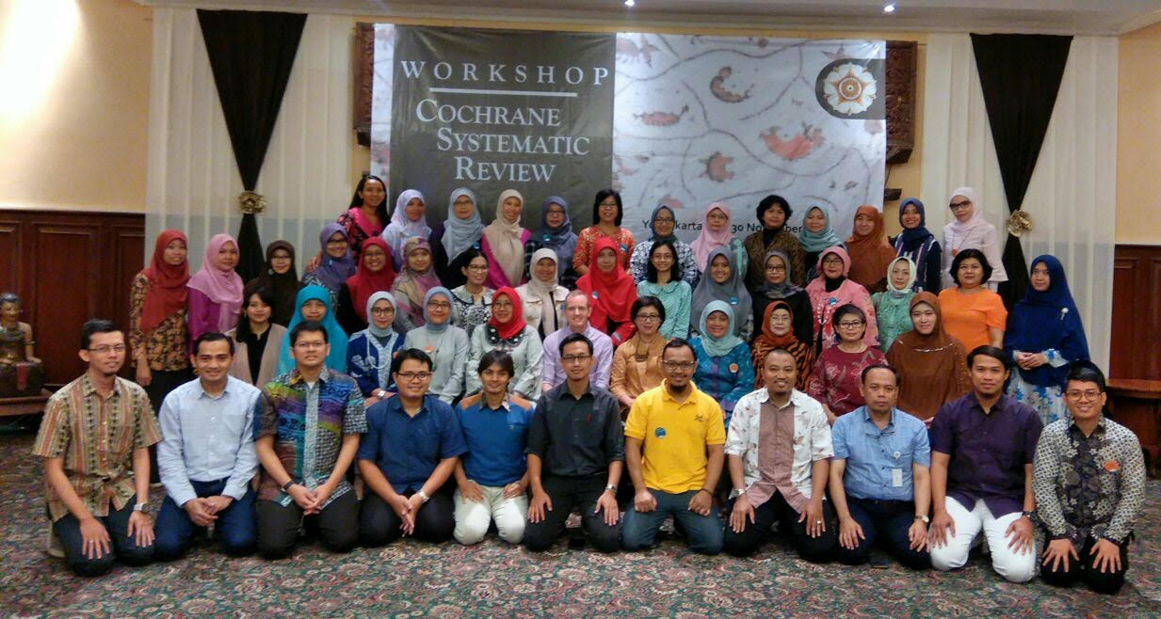
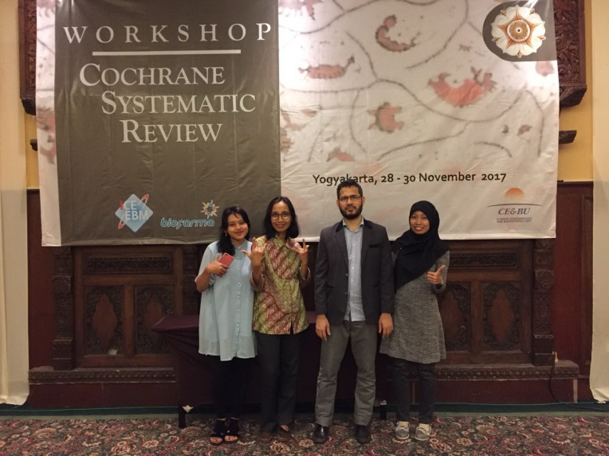
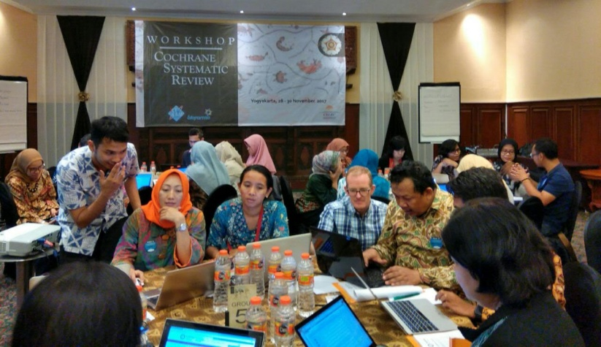
Activities 2017
International Training of Cochrane Systematic Review (CSR) – Support by Fac. Medicine & ICE-EBM

Slide 19
Activities 2017
Workshop EB-Clinical Practice Guideline - Support by ICE-EBM & FK UGM

Slide 20
Activities 2017
Board Meeting & Serah Terima Kepengurusan ICE-EBM

Slide 21
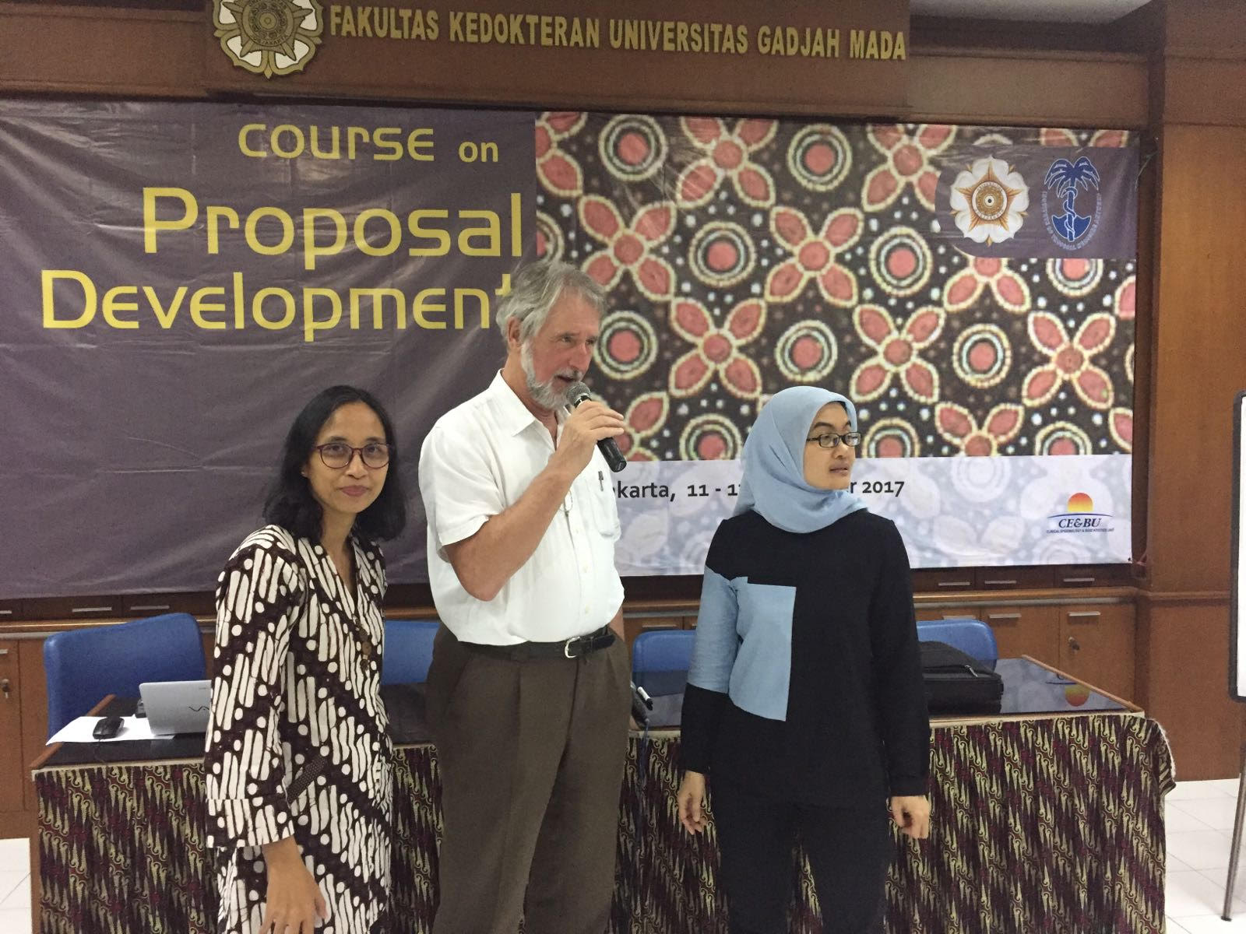
Activities 2017
Workshop Clinical Decision Making (CDM) & Proposal Development- Support by FK UGM

Slide 22
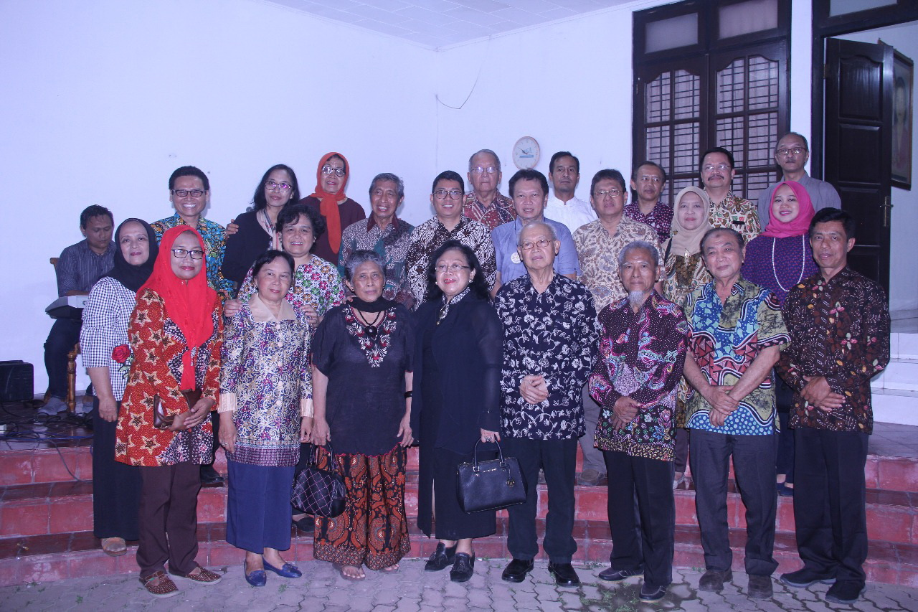
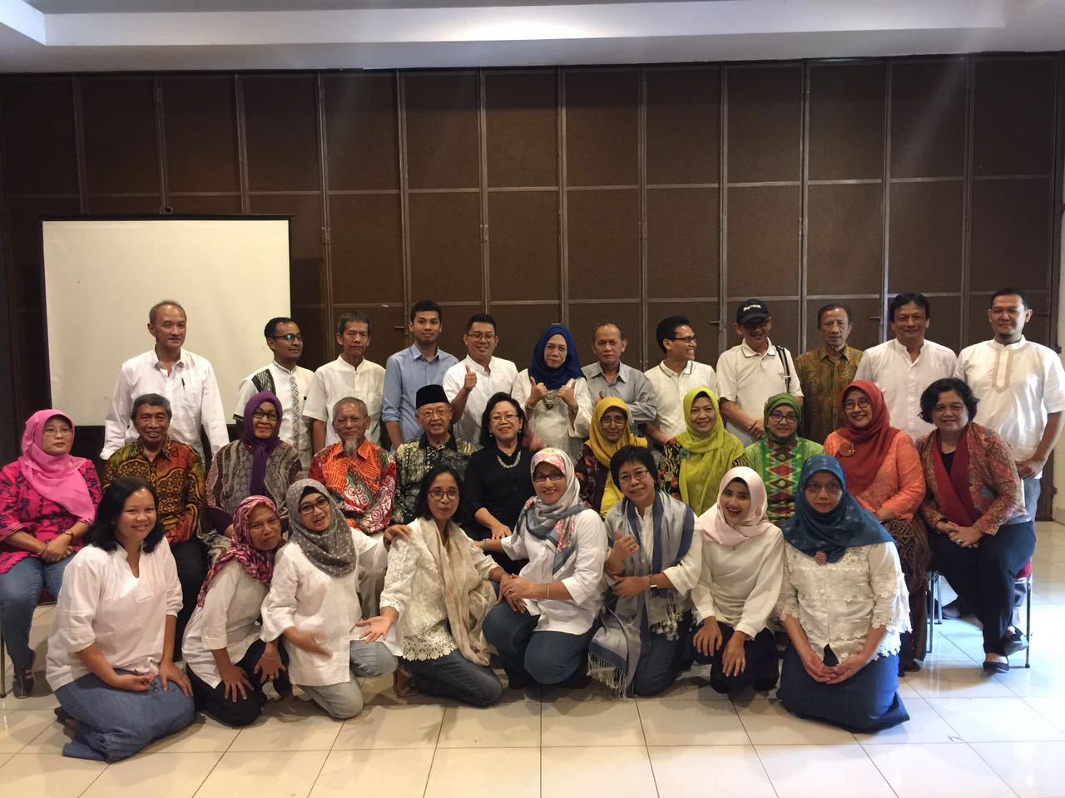
Activities 2017
Ramah Tamah BoD Syawalan CEBU

Slide 23
Target, program and Indicator 2018-2022
Objectives: Organize and conduct research in clinical, community and policy settings
 | Sasaran | Program
1 | Inter-Departement, Hospitals, Industries, Policy Maker | Clinical research interdepartment and interhospital within AHS including research on HTA, Post Marketing Surveillance, Drug utilization study, Development disease registry & data management center
INDIKATOR: number of registry, number of collaborative study & number of publication

Slide 24
Target, program and Indicator 2018-2022
Tujuan : Organizing and conducting seminars, trainings and workshops in clinical epidemiology, EBM, research methodology and biostatistics, and health technology assessment.
 | Sasaran | Program
2 | Academic staff, researchers, students, clinicians, industries, policy makers | Training/workshop/seminar on research methodology, biostatistics, HTA, clinical decision making, EBM, systematic review, clinical practice guideline, data management etc.
INDIKATOR: Number of training/workshop/seminar

Slide 25
Target, program and Indicator 2018-2022
Tujuan : Conducting research & training on research methodology, evidence based medicine and its implementation, collaboration with National & International Research Institutes
 | Sasaran | Program
3 | Academic staff, researchers, students, clinicians, industries, policy makers | Collaboration in training and research with National & International Institutions and with other International Centre of Clinical Epidemiology Indonesia Cochrane Center (ICC) Annual International Clinical Epidemiology Conference
INDIKATOR: Number of international collaboration

Slide 26
Target, program and Indicator 2018-2022
Tujuan : Supports undergraduate and postgraduate programs on training evidence-based medicine and research, and provides assistance and consultancy for health research
 | Sasaran | Program
4 | Undergraduate and Postgraduate Students | Undergraduate –block B5 (EBM) & Block B6 (Research), Postgraduate - clinical epidemiology, training research metodhology for residents. Data Analysis & Research Methods concultation Publishing Textbook of Clinical Epidemiology, Textbook of Evidence Based Medicine (EBM), Module of CDM & Buku Sejarah CEBU
 | INDIKATOR
The implementation of teaching and learning process Number of consultation students Textbooks

Slide 27
Board of Director
CE&BU
Ketua
Dr. Jarir At Thobari
Keuangan
Awang
Ipung
Sekretariat
Indah
Sutikno
Sekretaris Pusat
............................
Project Manager
Dewi Ismimasithoh
Pelatihan External
Dr. Pinson
Pelatihan Internal
(S1/S2/Sp/S3)
Dr. Osman Sianipar
Dr. Andaru
Dr. Bayu
Penelitian & Pengabdian
Dr. Rina Triasih
Dr. Awalia
Christantie PhD
Indonesia Cochrane
Centre
Dr. Detty N
Dr. Dama

Slide 28
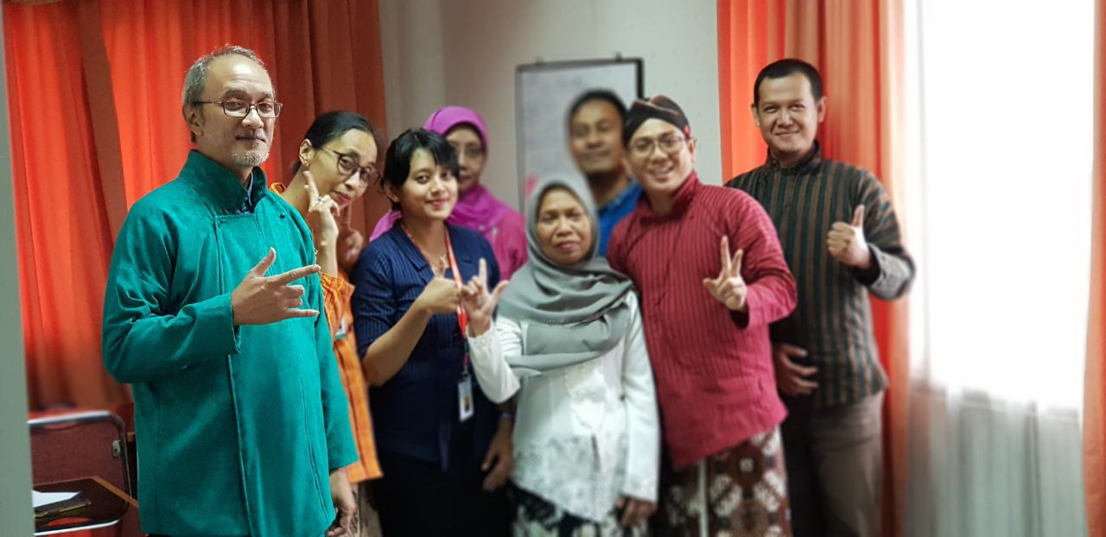
Thank you

Slide 29
Opportunity: CEBU mempunyai jaringan untuk penelitian di setiap departemen, menjadi pusat data (yang professional) penelitian di RS Sardjito. Lebih eksplisit menjadi pusat penelitian RS Sardjito.
Publikasi: jurnal
CEEBM: in house training dilakukan setiap enam bulan sekali, staff CEEBM merupakan full staff (PNS) RS Cipto, dan membuat PPK.
Melakukan kegiatan penelitian dan training terkait kebutuhan RS Sardjito dan AHS, kerjasama dengan Diklit dan Unit Rekam Medik

Slide 30
RS membutuhkan banyak data untuk melihat indikator mutu
RS akan membuat unit penelitian dan road map penelitian, anggaran 4% dari pendapatan RS Sardjito untuk penelitian dan pengembangan SDM
Urgensi tersedia nya database untuk penelitian
Kebutuhan kerjasama dengan klinisi dan data registry untuk kegiatan/penelitian mutu klinis (PKMK), memfasilitasi ke tim klinis

Slide 31
Tata Kelola: pemberdayaan staff dari departemen klinik melalui kelembagaan (support Kepala Departemen), terutama dari Departemen epidemiologi dan kesehatan populasi
Database pasien kesehatan jiwa
Konsultasi penelitian epidemiologi dan biostatistik bagi departemen
Website CEBU

