Slide 1
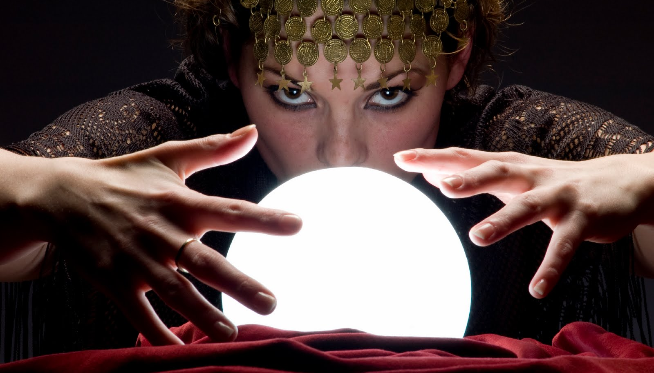
Outlook penelitian kesehatan dan publikasi ilmiah
Yodi Mahendradhata

Slide 2
The future
is already here.
It’s just not evenly distributed yet.
William Gibson

Slide 3
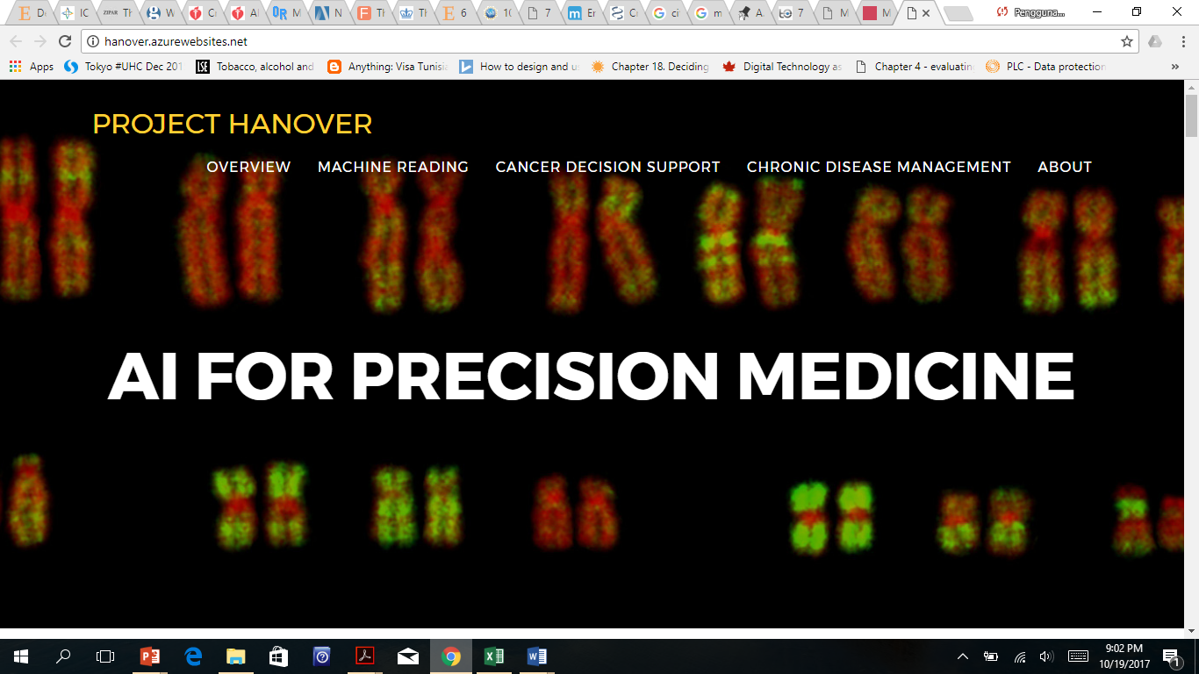

Slide 4
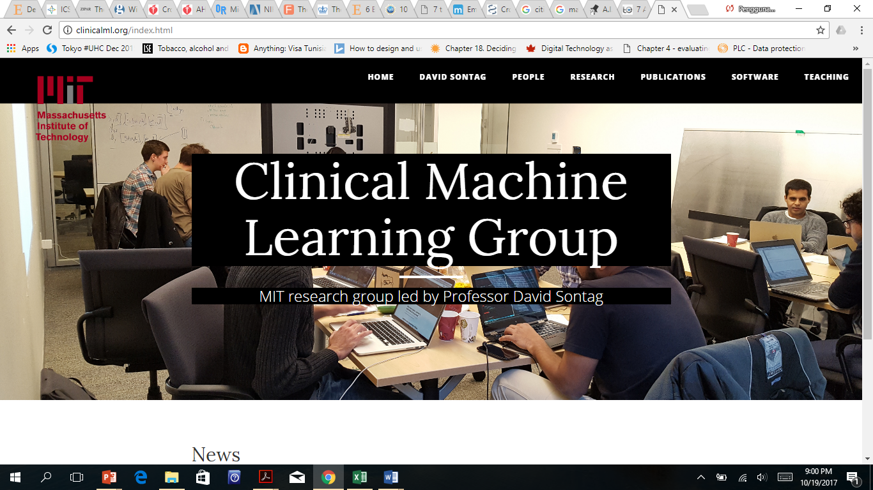

Slide 5
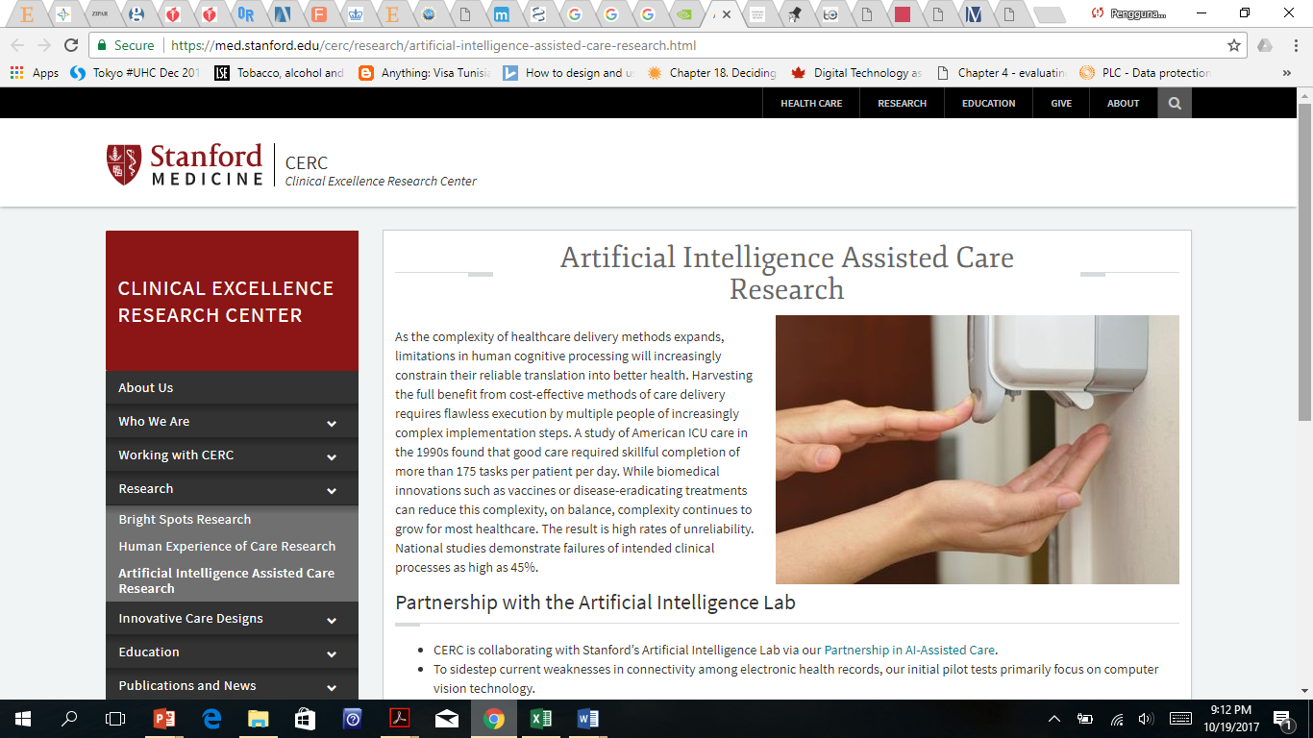

Slide 7
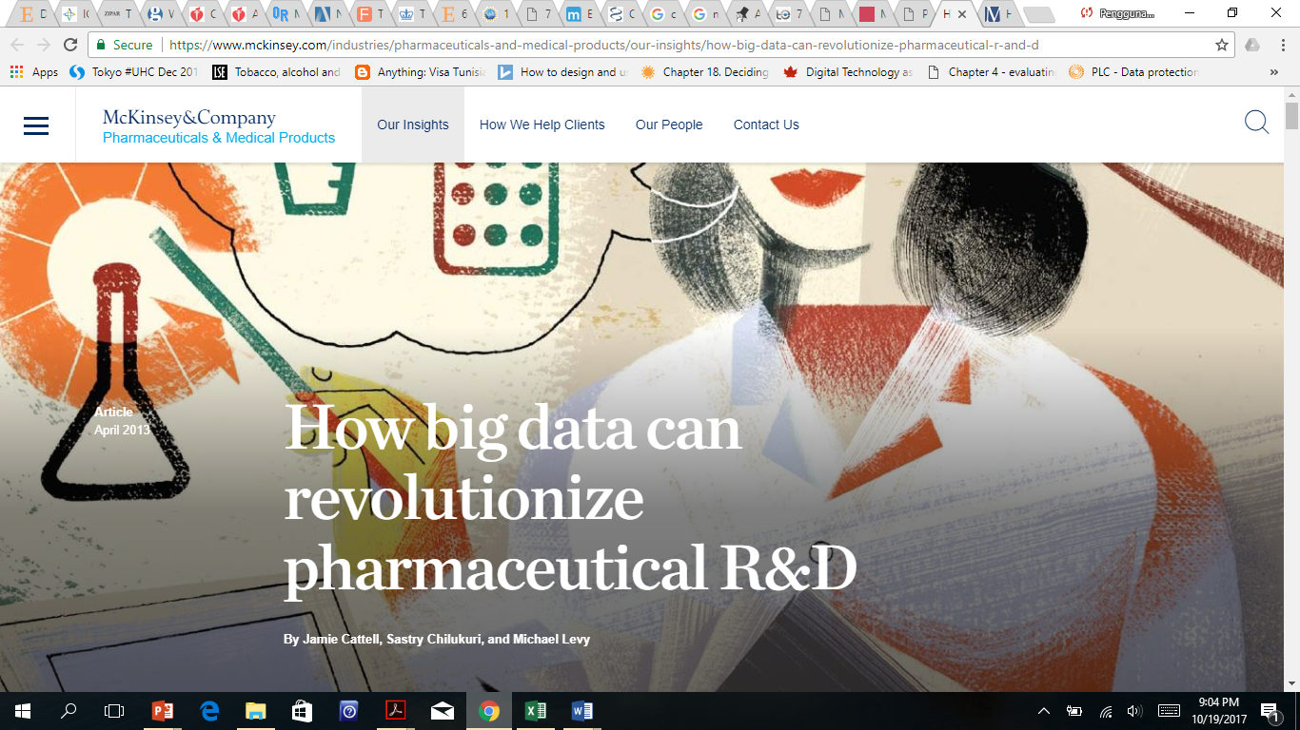

Slide 8
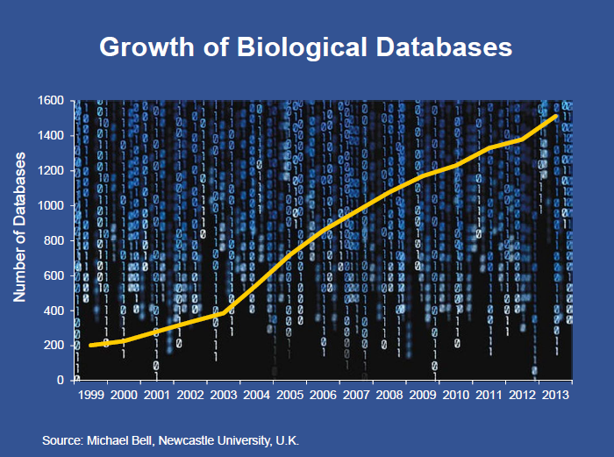

Slide 10
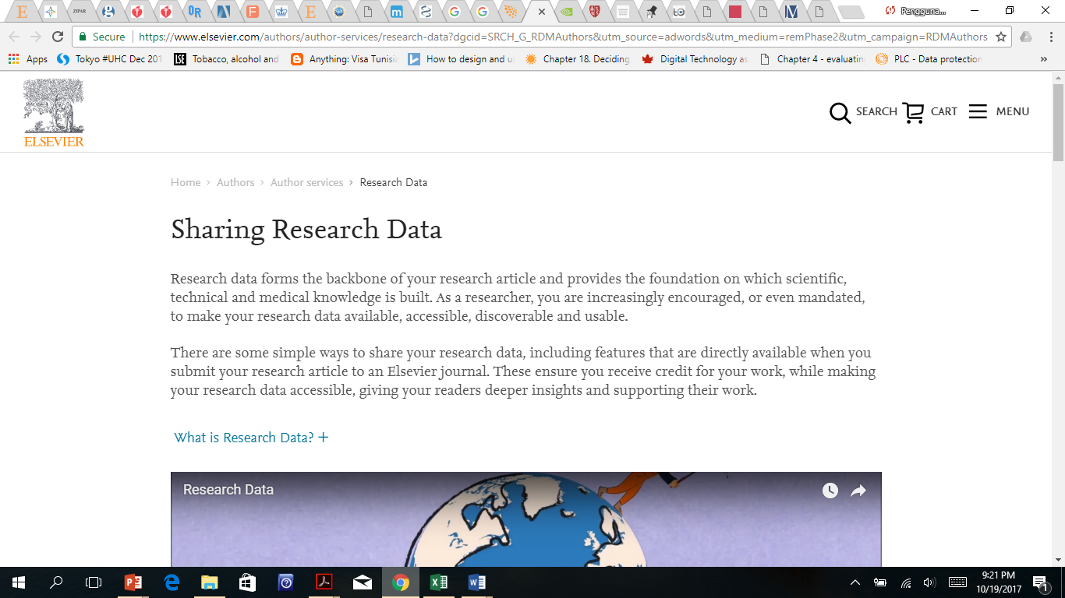

Slide 11
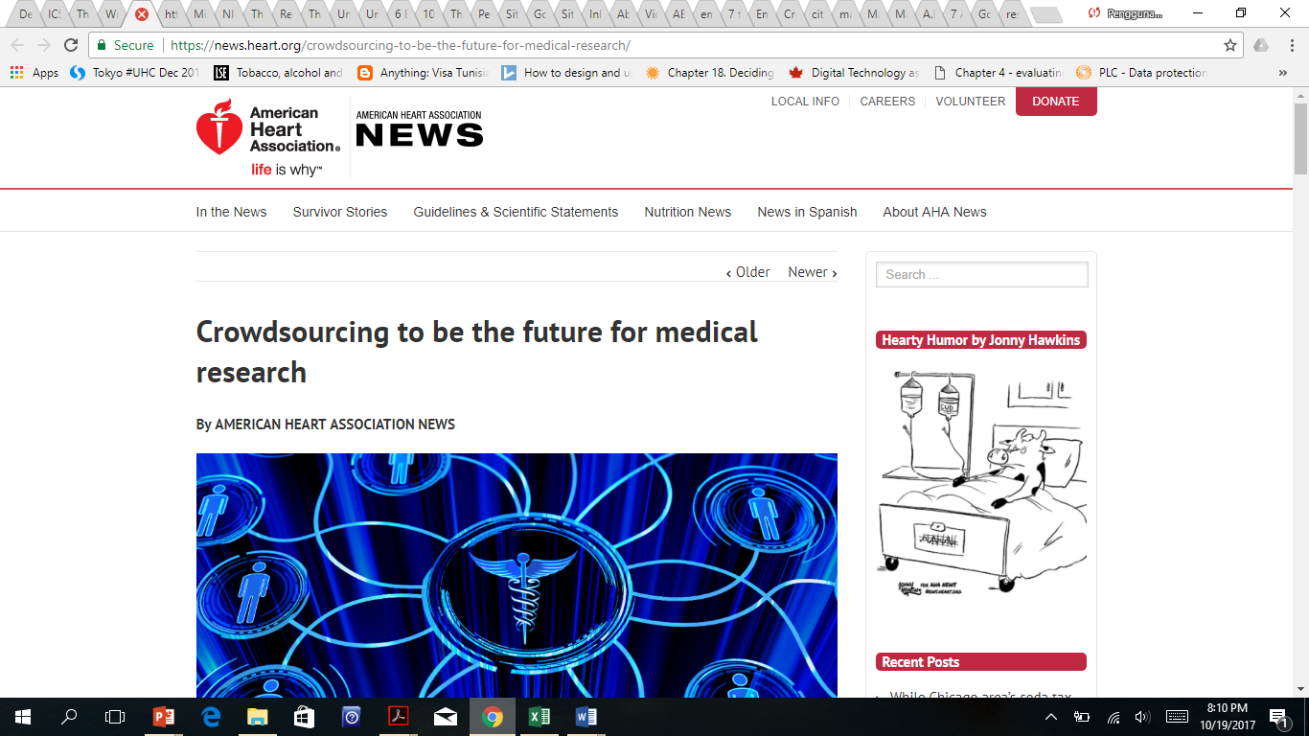

Slide 12
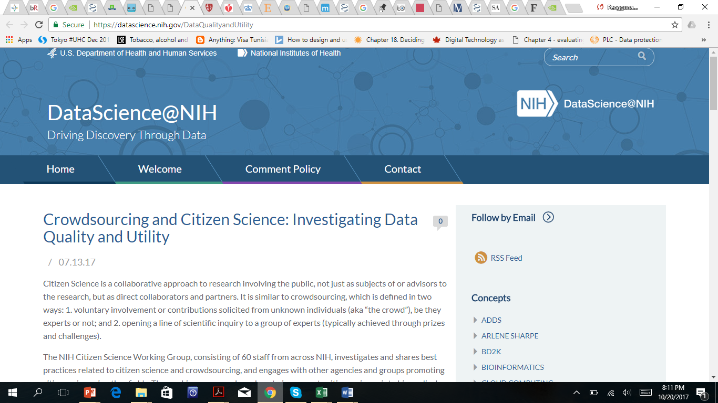

Slide 13
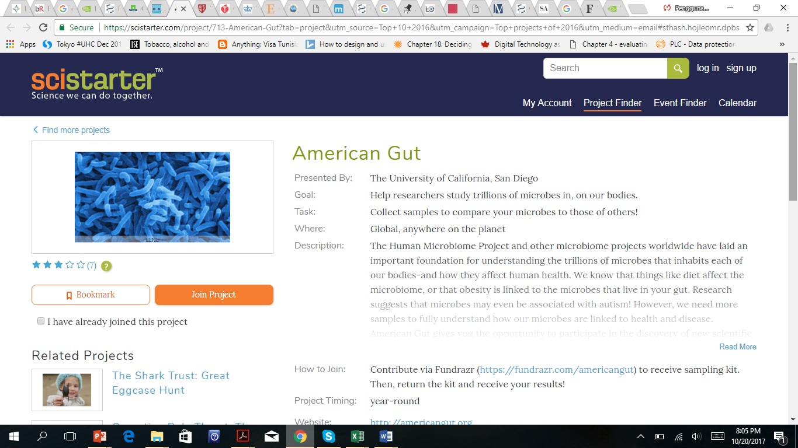

Slide 14
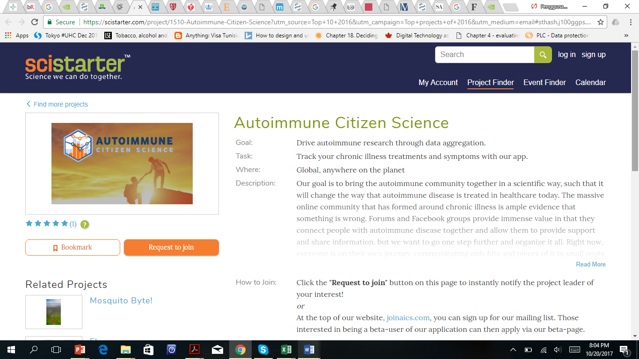

Slide 15
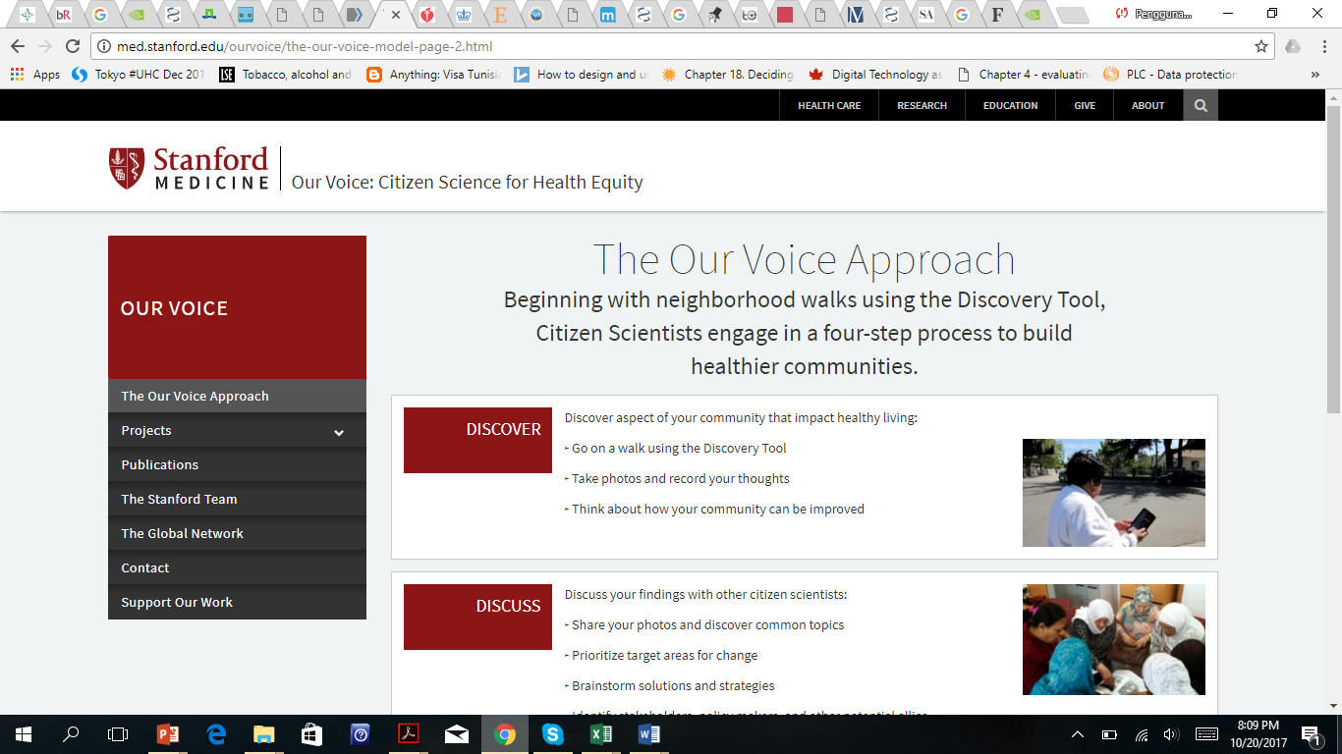

Slide 16
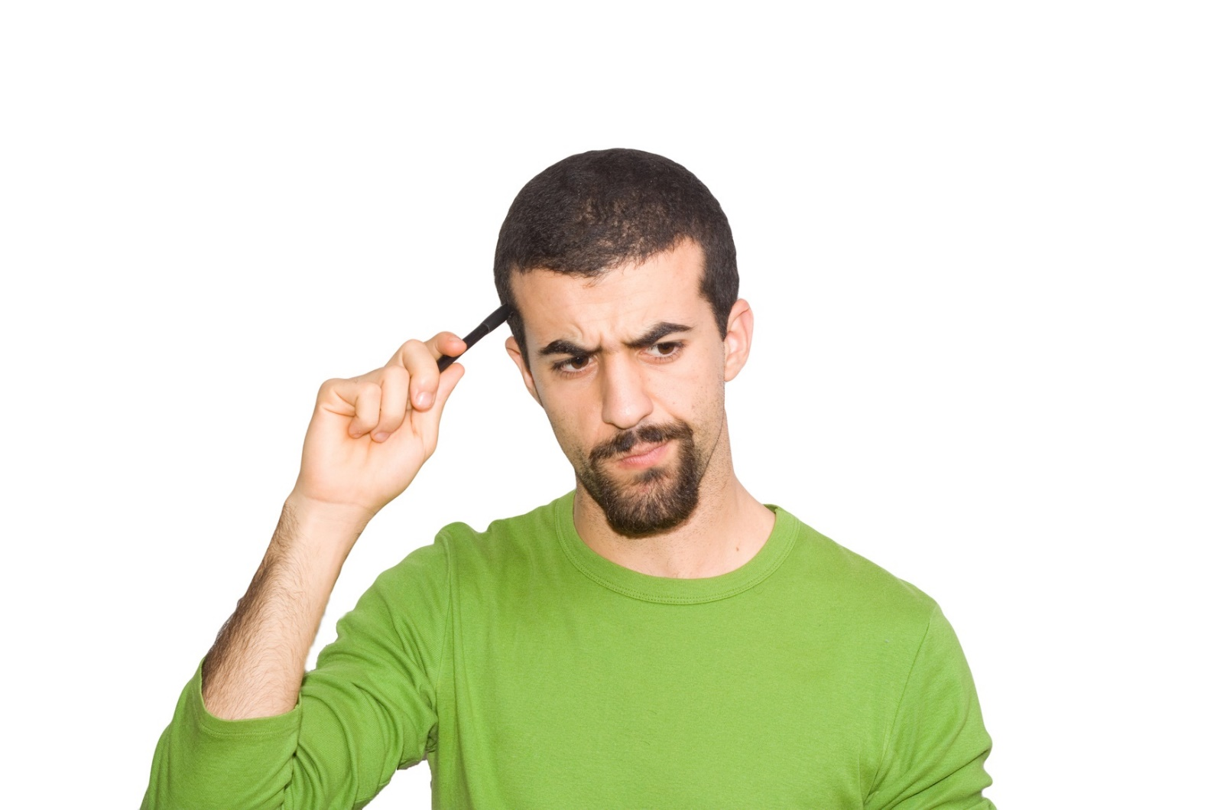
Promoting transdisciplinary science
Deep learning
Big data
Machine learning
Crowdsourcing
Artificial intelligence
Citizen science

Slide 17
Trends in social science research methods*
Digital qualitative methods
Online interviews and FGDs
Applied anthropology method
Complexity theory
Intersections of qualitative research practices with science
Design-based research
Critical race theory approach
*https://connection.sagepub.com/blog/sage-connection/2016/06/17/7-trends-in-research-methods/

Slide 18
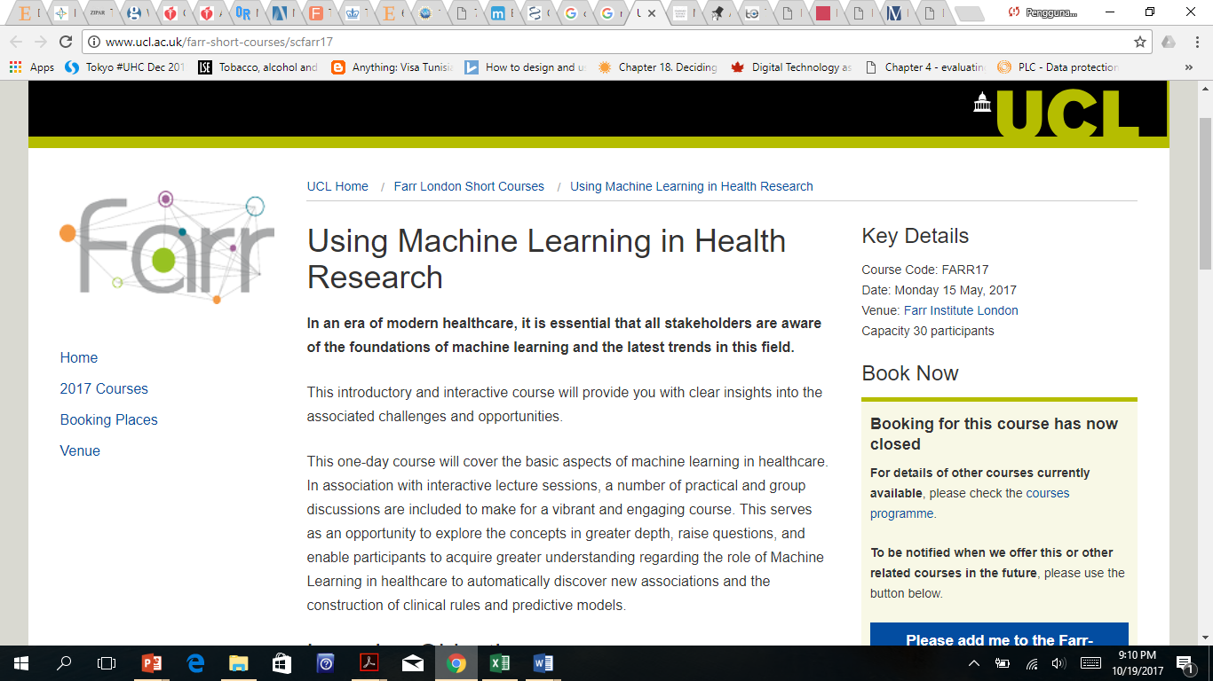

Slide 19
The future of scientific communication?

Slide 20
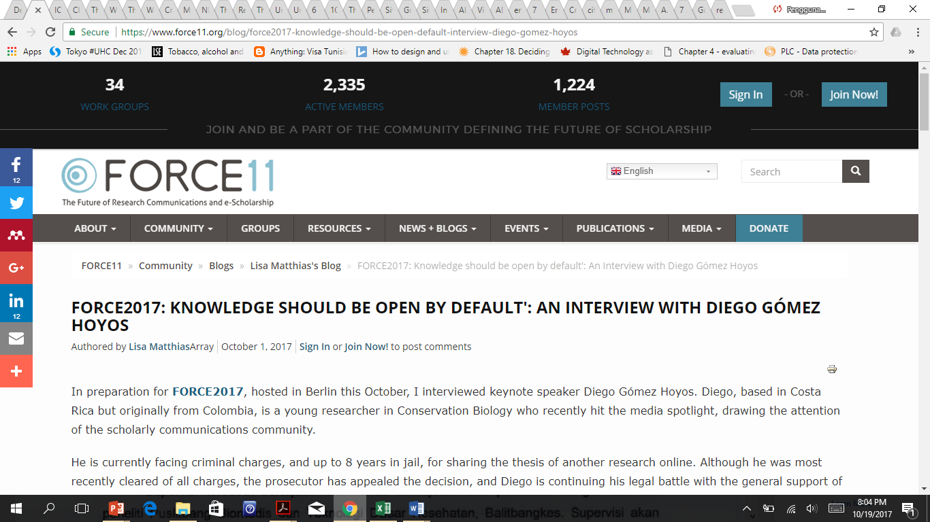

Slide 21
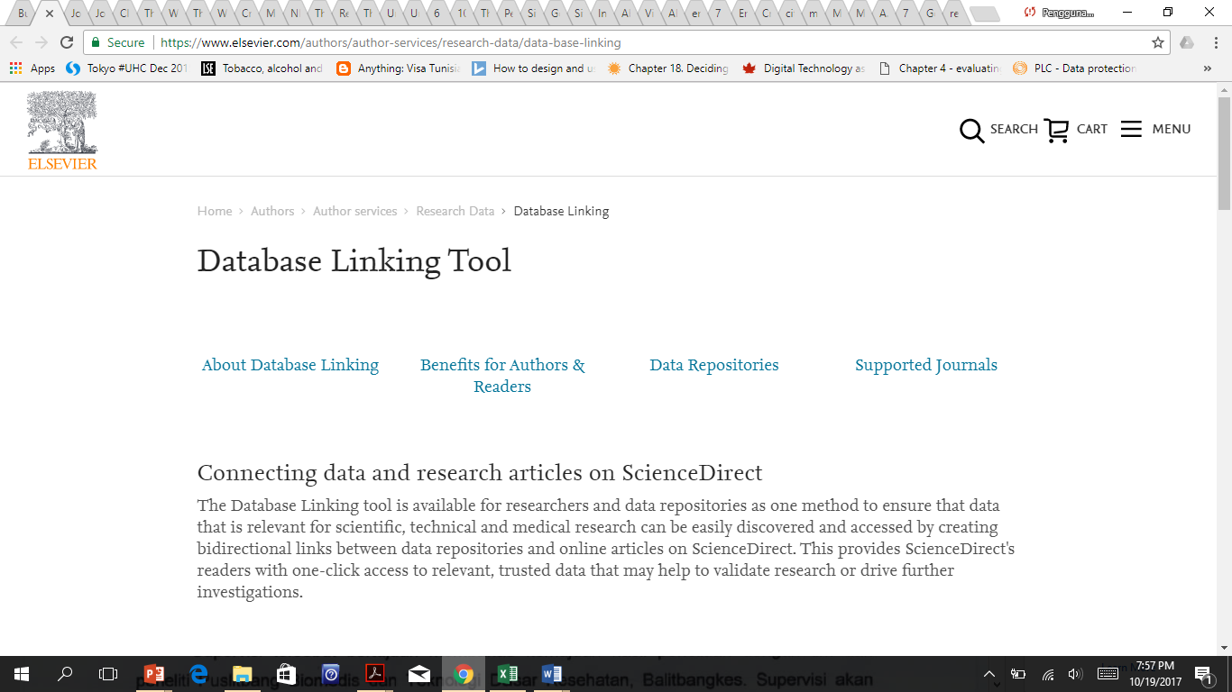

Slide 22
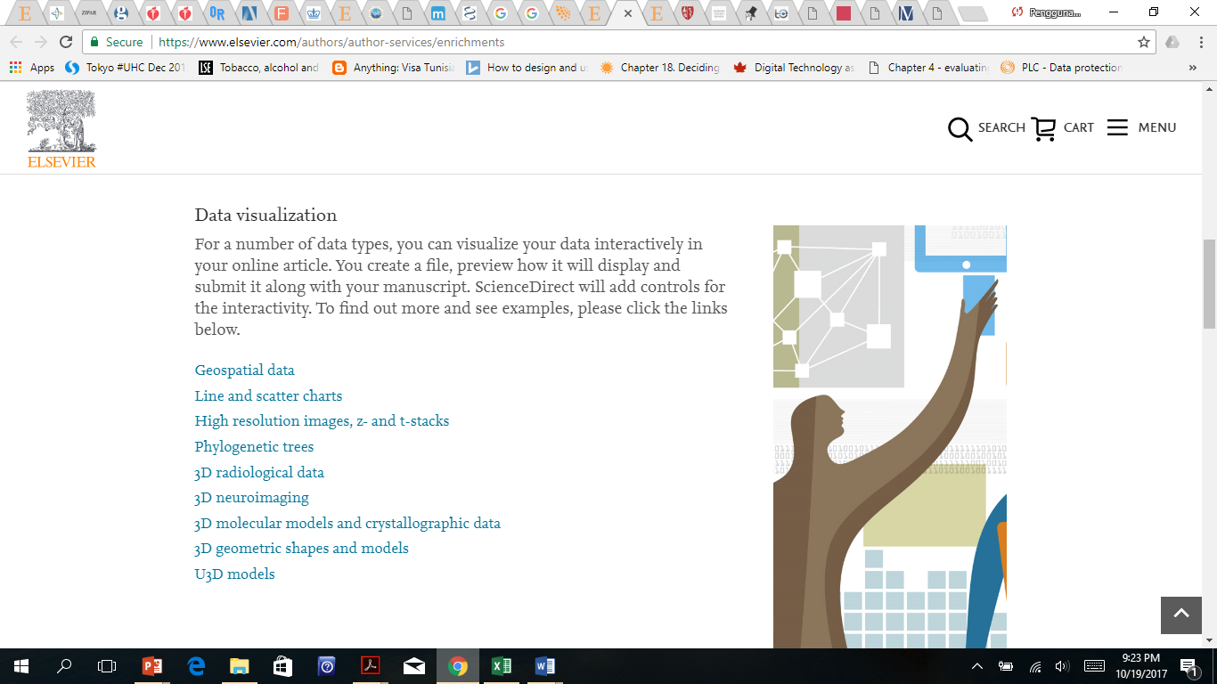

Slide 23
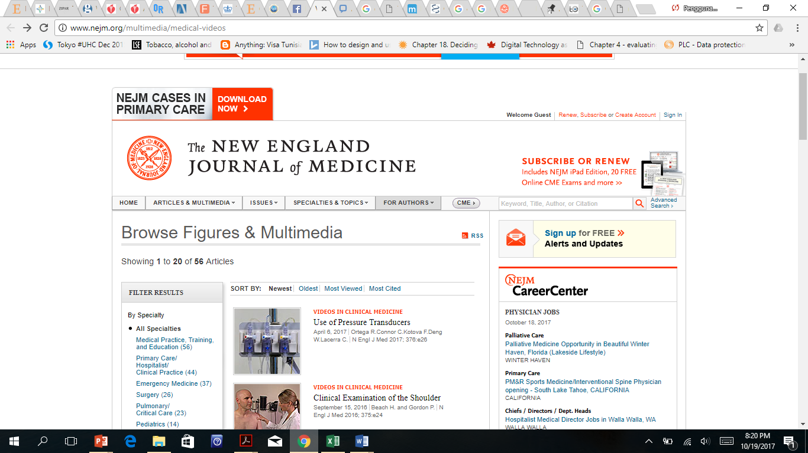

Slide 24
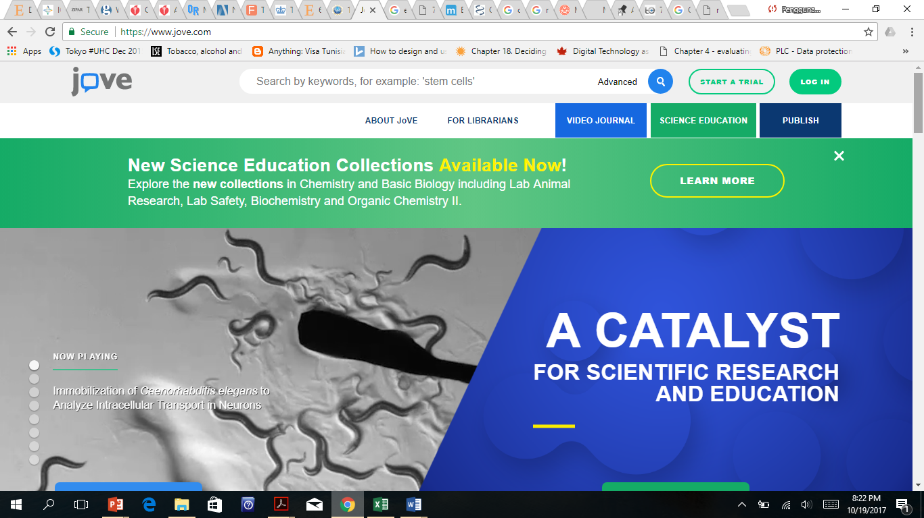

Slide 25
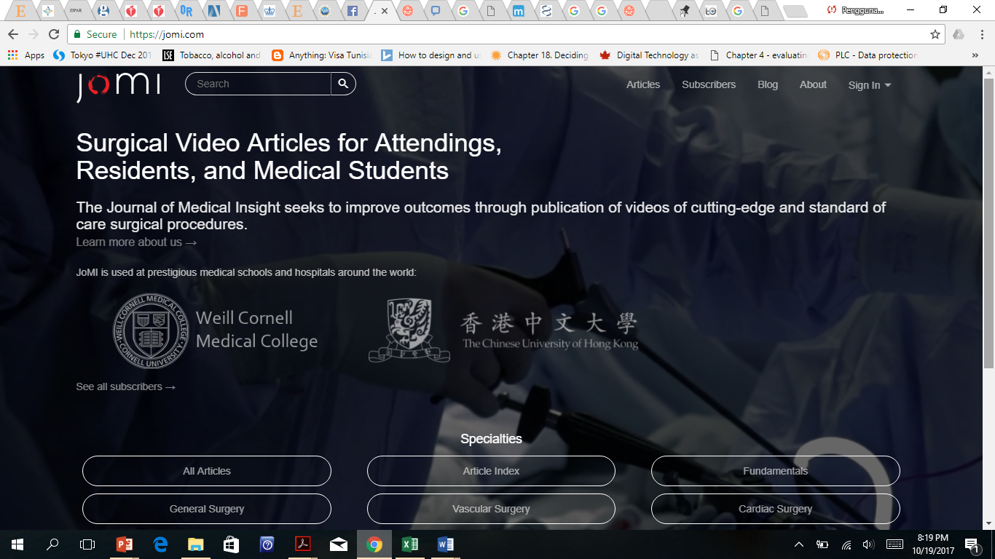

Slide 26
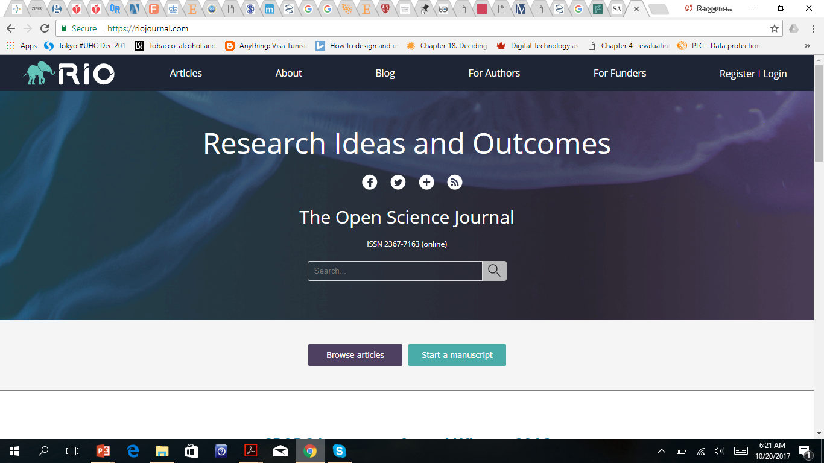

Slide 27
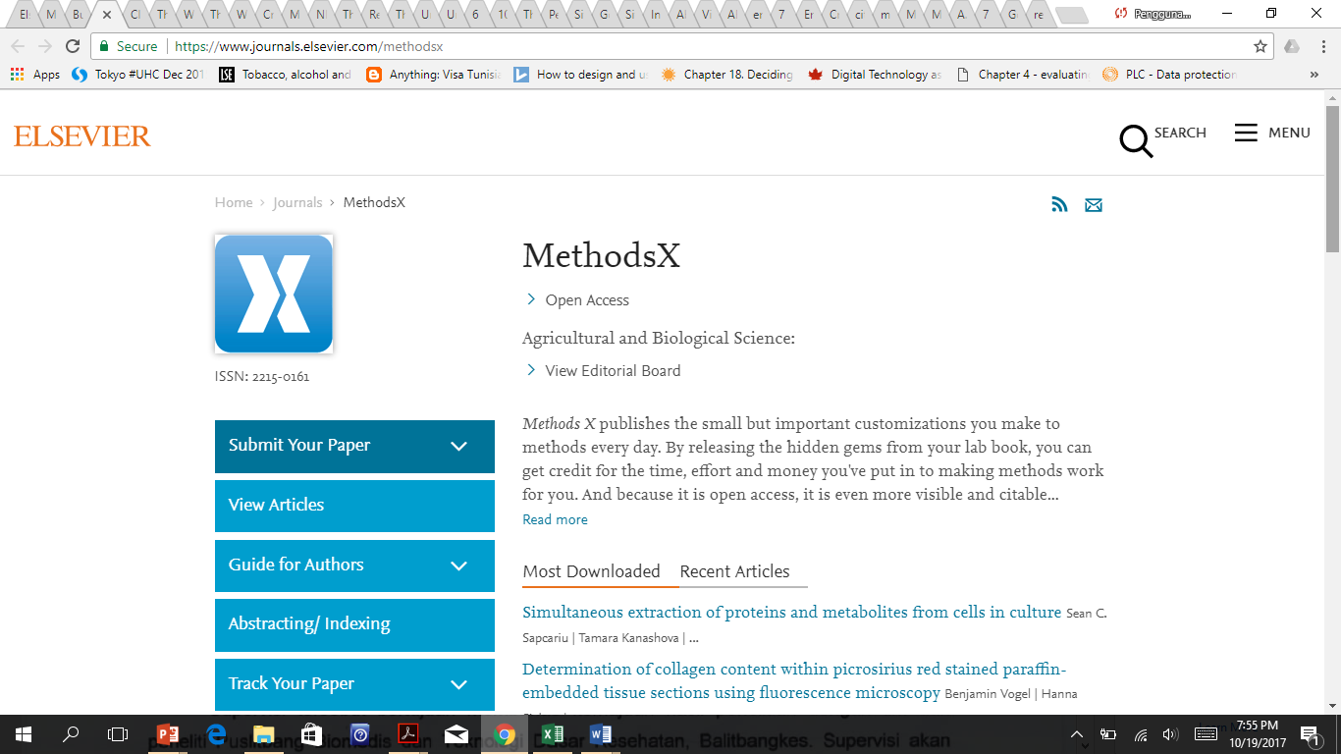

Slide 28
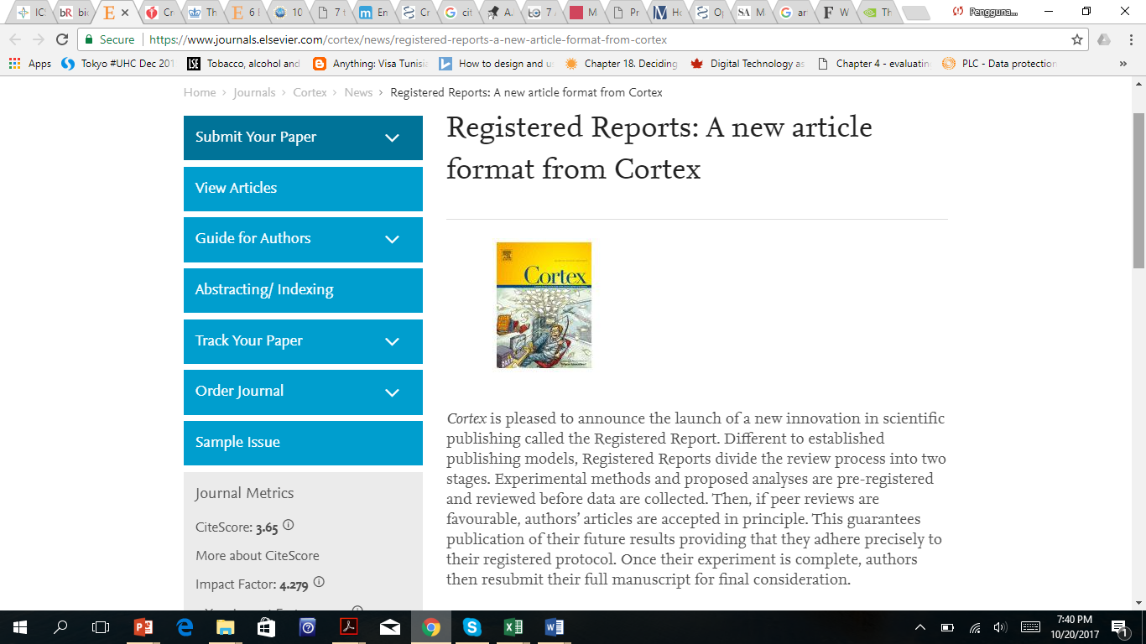

Slide 29
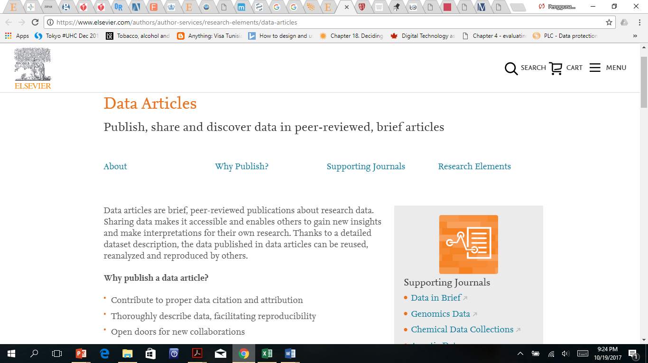

Slide 30
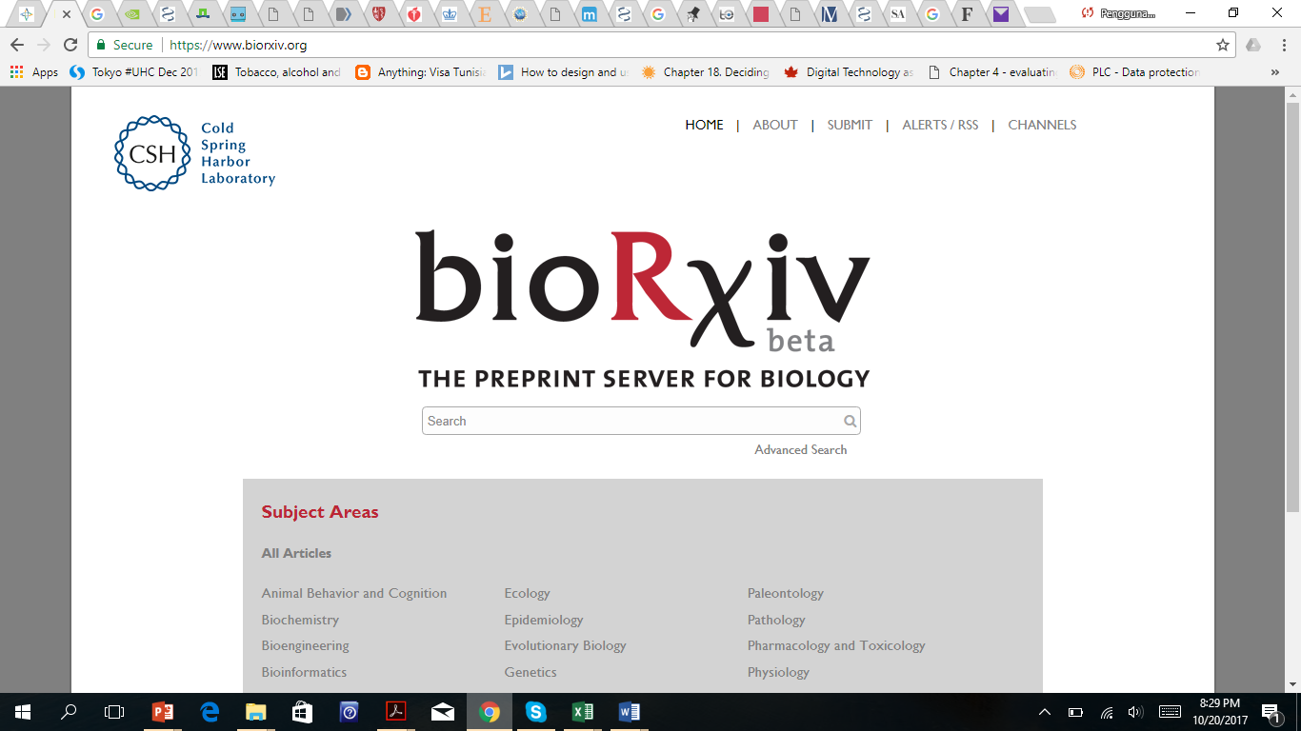

Slide 31
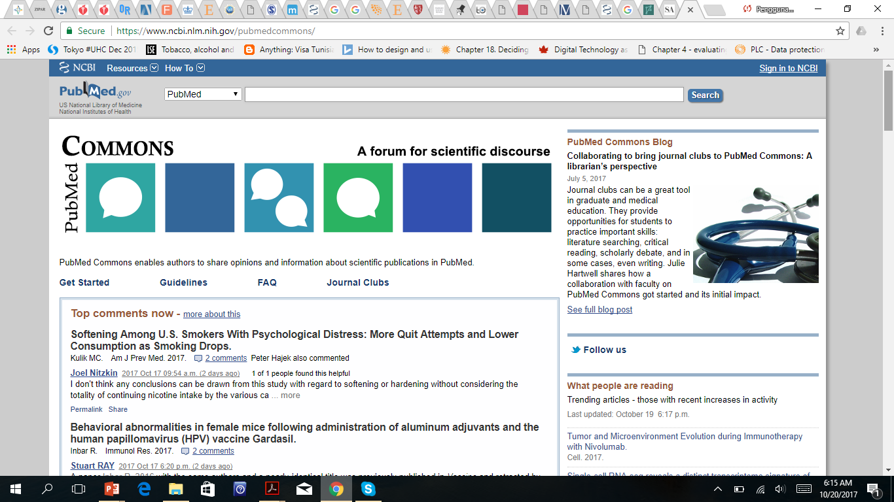

Slide 32
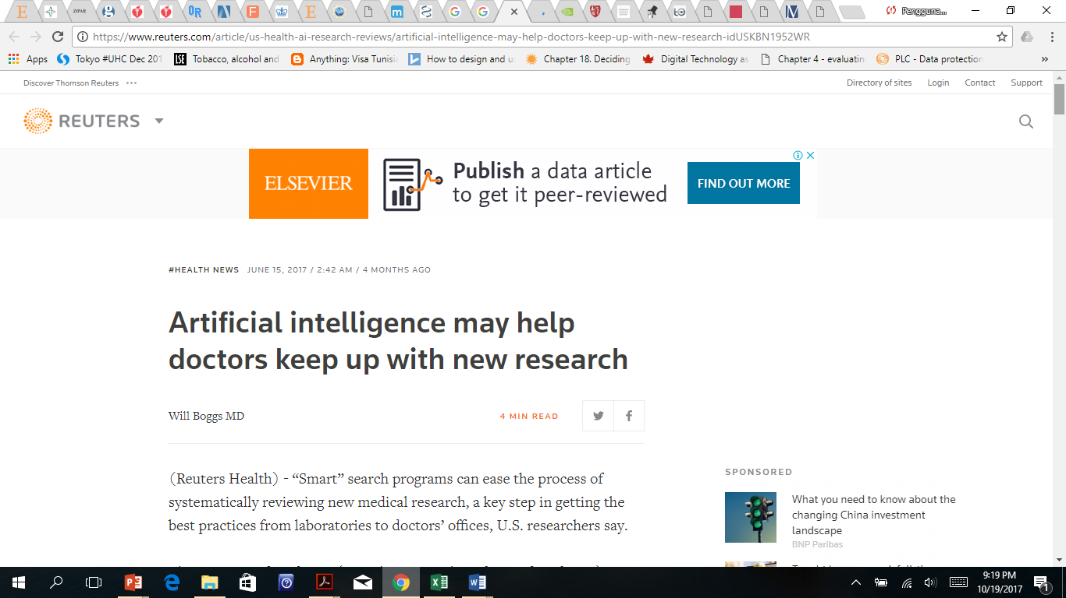

Slide 33
Implikasi-implikasi stratejik bagi FK UGM?

Slide 34

World class science, real world impact

