Slide 1
Rencana Pengembangan RSUP Dr. Sardjito
Modern, Melayani, Terpercaya
Direksi RSUP Dr. Sardjito
2017
Notes:
Oleh Rukmono Siswishanto, 21 Oktober 2017
Dipresentasikan dihadapan Workshop Pengembangan Renstra FKUGM & AHS

Slide 2
Outline
Tantangan bagi RSUP Dr. Sardjito
Visi & Misi
Dasar pengembangan
Arah Pengembangan
Usulan-usulan menyusun rencana tindak lanjut stratejik

Slide 3
Visi Menjadi Rumah Sakit Pendidikan dan Rujukan Nasional berstandar internasional yang terkemuka pada tahun 2019
Misi
Memberikan pelayanan kesehatan, pendidikan & pelatihan, penelitian & pengembangan iptekdok, kesejahteraan
Tagline
Mitra terpercaya menuju sehat
Notes:
Help our people live a long and healthy life and support them with thoughtful and dignified care to the end.”
Provide good quality, affordable and hassle-free healthcare with science, love and wisdom
Touching lives, Pioneering Care, Making a Difference

Slide 4
Prioritas kami
Pasien kami adalah orang paling penting di rumah sakit ini. Kami menempatkan kesejahteraan, kepentingan, dan kenyamanan pasien kami sebelum kami sendiri, di segala sesuatu yang kami lakukan.
Notes:
Our patients are the most important people in this hospital. We put the well-being, interests and convenience of our patients before our own in everything that we do.

Slide 5
Nilai-nilai Dasar RSUP Dr. Sardjito
Profesionalisme
Kepedulian
Kepuasan pelanggan
Efisiensi
Notes:
Integrity: we are committed to the highest standards of ethical conduct
Compassion: our paramount concern is the welfare and well-being of our fellow human being. We empathies with those struck by illness and suffering an will do our utmost to help alleviate their condition
Professionalism: We are committed to being the best in what we do, and to achieving the best outcome for our patient
Respect: To treat everyone with honesty, decency and fairness
Collegiality: We nurture success by promoting collaboration, participation and trust between individuals within an environment of sharing and mutual respect
Sosial responsibility: we contribute positively to the well-being and welfare of the community

Slide 6
Pasar Bebas MEA (31 Desember 2015)
Teknologi Kedokteran & Informasi
JKN (BPJS dan rujukan berjenjang)
Sistem Remunerasi
Orientasi Pelanggan
Orientasi Pengorganisasian Yankes
Notes:
MEA (10 negara, by 31 Dec 2015)): Indonesia, Filipina, Singapore, Malaysia, Thailand, Brunei Darussalam, Vietnam, Laos, Myanmar, & Kamboja
Orientasi pelanggan: service quality – service excellence; service transaction-service experience; serving patients-delighting patient
Orientasi pengorganisasian: patient centered care (integrated care plan)
RSUD Kotamadya menjadi pusat rujukan regional, sedangkan RSUP Dr. Sardjito menjadi pusat rujukan nasional (ini berpotensi menuimbulkan kerancuan)

Slide 7
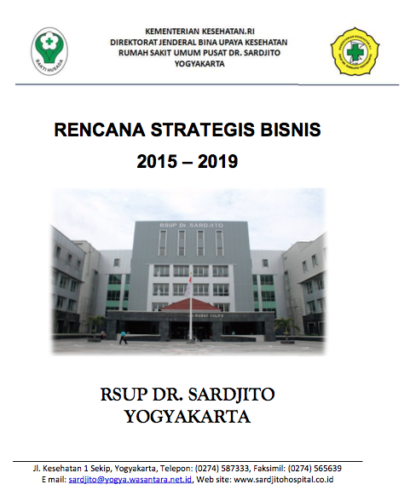

Slide 8
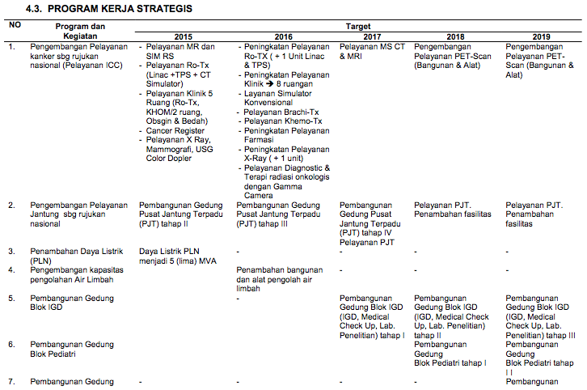

Slide 9
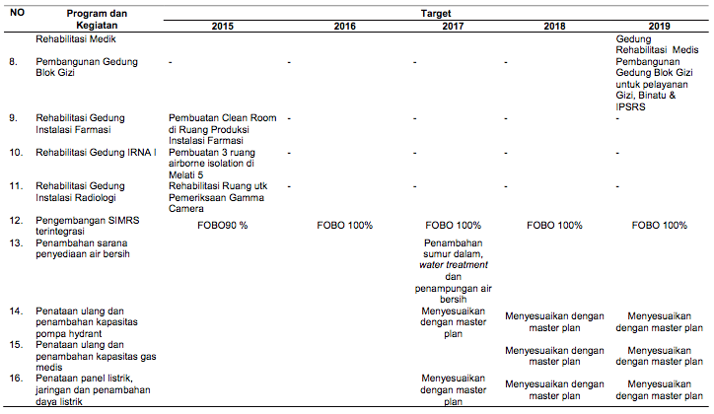

Slide 10
Area Kerjasama Dalam Konteks AHS
Pendidikan & Pelatihan
Riset (Implementasi & Translasional)
Pengembangan & Perbaikan Pelayanan Klinis
Pengembangan & Perbaikan Lingkungan & Masyarakat
Supporting office

Slide 11
8 Kebutuhan Perbaikan
Produk yang terukur/ output
Pengembangan Kapasitas SDM
Pendidikan & Pelatihan Berkelanjutan
Gedung, Peralatan & Material
Prosedur Operasional Terstandar
Dukungan Sistem IT (backbone)
Jejaring & Tim (untuk setiap aktifitas)
Keuangan & Anggaran

Slide 12
BUILDING BLOCK FOR RSUP DR SARDJITO EXCELLENCE
VISION & MISSION
INDONESIA QUALITY AWARD
ORGANIZATION EXCELLENCE
JCI/ KARS ACCREDITATION
PREMIUM QUALITY CLASS
BALANCED SCORE CARD
HIGH LEVEL OUTCOME
CLINICAL, PROCESS & SERVICE/ OPERATION EXCELLENCE
PEOPLE EXCELLENCE
Quality & Cost Effective Care & Services
Social Responsibility to Environment & Community
Safe Work Environment for Patients & Staffs
Learning Environment
CONTINUAL IMPROVEMENT
IMPROVED CARE & LOWER (AFFORDABLE) COST
TOYOTA PRODUCTION SYSTEM/ LEAN MANAGEMENT/ PSBH
CPIP, 6-SIGMA, QC Projects
Reduce, Reuse, Recycle Resources
Reduce Health & Safety Risk
Learning Growth
SYSTEM FRAMEWORK
Quality: ISO 9001
Laboratory: CAP Accreditation
Environment: ISO 14001
Health & Safety: OHSAS 18001
Food Safety: HACCP
People: PDS
Quality, Environmental, Health & Safety Management, System Culture, Systems, Tools
CORE VALUES
Rukmono Siswishanto
Forum Idea RSUP Dr. Sardjito

Slide 13
Prinsip Peningkatan Mutu
Direktorat Medik & Keperawatan
Keterlibatan staf dan rasa memiliki
Client mind-set
Berfokus pada sistem & proses
Sadar biaya & efisiensi
Pembelajaran, pengembangan layanan, & pengembangan kapasitas berkelanjutan
Peningkatan mutu berkelanjutan

Slide 14
Usulan-usulan

Slide 15
Pelayanan Klinis
Yunior
50%
Pendidikan
35%
Pelatihan
15%
Riset
Senior
Remunerasi

Slide 16
Pelayanan Rutin
(existing)
Penguatan modalitas:
Minimally invasive surgery
Endoscopic/ robotic
Stem cell
Immunotherapy
Telemedicine
Skill lab (dry & wet)
Pengembangan Pelayanan Transdisiplin
Cangkok hati (anak & dewasa)
Cangkok sumsum tulang
Cangkok ginjal
Aplikasi stem cell
(Kembar siam), dll
± 20%
Pusat Pelayanan Terintegrasi
Onkologi
Kardiologi
Neurovaskular
Health tourism (GCU, ODC, & CAM)
Arah Pengembangan Pelayanan Klinis

Slide 17
4 Customer Values
Fasilitas
Manajemen
Customer solution
Cost
Convenience
Communication
Teknologi skrining, diagnosis, & terapi yang tepat guna
Sistem IT yang canggih
Disease Registry
Clinical trial/ research ward
Sistem yang diimplementasikan
People & education
Delivery & distribution
Testing & measuring
Systems & technology
Board (minimal 3 KSM)
7 Sinergi:
Pelayanan
Pendidikan
Penelitian
Keuangan
Aset
SDM
Hukum
Pusat Pelayanan Terintegrasi

Slide 18
Pelayanan & Aktifitas Rutin
(existing)
Skema pembiayaan
Rutin
Pengembangan Pelayanan Transdisiplin
Skema pembiayaan Inkubasi
Pusat Pelayanan Terintegrasi
Skema pembiayaan Filantrofi
Skema Pembiayaan
Notes:
Pelayanan dan aktifitas rutin termasuk untuk CSR (pemberdayaan masyarakat & jejaring, perbaikan mutu lingkungan)

Slide 19
● Aktifitas klinis
● SDM/ ketenagaan
● Outcome klinis
● Insiden/ keluhan/ kepuasan
 | RS (Korporasi) | Bidang/ Bagian | Satuan Kerja | Individu
Aktifitas/ proses klinis
SDM/ ketenagaan
Outcome (klinis/ manajerial)
Insiden/ keluhan/ kepuasan
Dashboard untuk akuntabilitas
Clinical Performance and Governance Score Card

Slide 20
Contoh Masalah ti(n)daklanjut

Slide 22
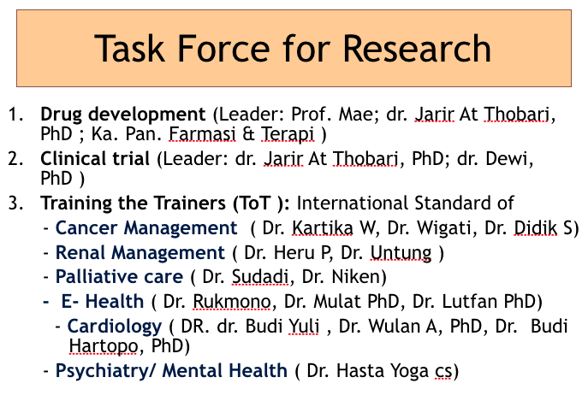

Slide 23
terimakasih

