Slide 1
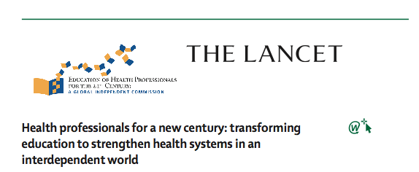
Frenk, Julio, Lincoln Chen, Zulfiqar A. Bhutta, Jordan Cohen, Nigel Crisp, Timothy Evans, Harvey Fineberg, et al. 2010. Health professionals for a new century: transforming education to strengthen health systems in an interdependent world. The Lancet 376(9756): 1923-1958.

Slide 2
1900
2000+
Science -based
Problem-based
System-based
Instructional
Institutional
Scientific Curriculum
University Based
PBL
Academic Centre
Competency driven Local global
Health Education System

Slide 3
 | Objectives | Outcomes
Informative | Information, Skills | Expert
Formative | Socialization, Values | Professionals
Transformative | Leadership Attributes | Change Agents
Level of Learning

Slide 4
Instructional reforms
Admission
Graduation
Generate a diverse student body with a competency-based curriculum that, through the creative use of information technology (IT), prepares students for the realities of teamwork, to develop flexible career paths that are based on the spirit and duty of a new professionalism

Slide 5
Adoption of competency-based curricula that are responsive to rapidly changing
needs rather than being dominated by static coursework.
Competencies should be adapted to local contexts and be determined by national stakeholders, while harnessing global knowledge and experiences. Simultaneously, the present gaps should be filled in the range of competencies that are required to deal with 21st century challenges common to all countries—eg, the response to global health security threats or the management of increasingly complex health systems.
1
Competency-based curricula

Slide 6
Promotion of interprofessional and transprofessional education that breaks down professional silos while enhancing collaborative and non-hierarchical relationships in eðective teams. Alongside specific technical skills, interprofessional education should focus on cross-cutting generic competencies, such as analytical abilities (for effective use of both evidence and ethical deliberation in decision making), leadership and management capabilities (for efficient handling of scarce resources in conditions of uncertainty), and communication skills (for mobilisation of all stakeholders, including patients and populations).
2
Inter-transprofessional education

Slide 7
Exploitation of the power of IT for learning through development of evidence, capacity for data collection and analysis, simulation and testing, distance learning, collaborative connectivity, and management of the increase in knowledge. Universities and similar institutions have to make the necessary adjustments to harness the new forms of transformative learning made possible by the IT revolution, moving beyond the traditional task of transmitting information to the more challenging role of developing the competencies to access, discriminate, analyse, and use knowledge. More than ever, these institutions have the duty of teaching students how to think creatively to master large flows of information in the search for solutions.
3
IT for learning

Slide 8
4
Adaptation locally but harnessing of resources globally in a way that confers capacity to flexibly address local challenges while using global knowledge, experience, and shared resources, including faculty, curriculum, didactic materials, and students linked internationally through exchange programmes
Adaptation locally but harnessing
of resources globally

Slide 9
5
Strengthening of educational resources, since faculty, syllabuses, didactic materials, and infrastructure are necessary instruments to achieve competencies. Many countries have severe deficits that require mobilising resources, both financial and didactic, including open access to journals and teaching materials. Faculty development needs special attention through increased investments in education of educators, stable and rewarding career paths, and constructive assessment linked to incentives for good performance
Strengthening of educational resources

Slide 10
6
Promote a new professionalism that uses competencies as the objective criterion for the classification of health professionals, transforming present conventional silos. A set of common attitudes, values, and behaviours should be developed as the foundation for preparation of a new generation of professionals to complement their learning of specialties of expertise with their roles as accountable change agents, competent managers of resources, and promoters of evidence-based policies.
Strengthening of educational resources

Slide 11
Institutional reforms
Institutional reforms should align national efforts through joint planning especially in the education and health sectors, engage all stakeholders in the reform process, extend academic learning sites into communities, develop global collaborative networks for mutual strengthening, and lead in promotion of the culture of critical inquiry and public reasoning.

Slide 12
Establishment of joint planning mechanisms in every country to engage key stakeholders, especially ministries of education and health, professional associations, and the academic community, to overcome fragmentation by assessment of national conditions, setting priorities, shaping policies, tracking change, and harmonising the supply of and demand for health professionals to meet the health needs of the population. In this planning process, special attention should be paid to sex and geography. As the proportion of women in the health workforce increases, equal opportunities need to be in place—eg, through more flexible working arrangements, career paths that accommodate temporary breaks, support to other social roles of women such as child care, and an active stance against any form of sex discrimination or subordination. With respect to geographical distribution, emphasis should be placed on recruitment of students from marginalised areas, orderring financial and career incentives to providers serving these areas, and deploying the power of IT to ease professional isolation
1
Joint planning mechanisms

Slide 13
2
Expansion from academic centres to academic systems, extending the traditional discovery-care-education continuum in schools and hospitals into primary care settings and communities, strengthened through external collaboration as part of more responsive and dynamic professional education systems.
Academic System

Slide 14
Linking together through networks, alliances, and consortia between educational institutions worldwide and across to allied actors, such as governments, civil society organisations, business, and media. In view of faculty shortages and other resource constraints, every developing country is unlikely to be able to train on its own the full complement of health professionals that is required. Therefore, regional and global consortia need to be established as a part of institutional design in the 21st century, taking advantage of information and communication technologies. The aim is to overcome the constraints of individual institutions and expand resources in knowledge, information, and solidarity for shared missions. These relations should be based on principles of non-exploitative and non-paternalistic equitable sharing of resources to generate mutual benefit and accountability.
3
Linking together

Slide 15
4
Nurturing of a culture of critical inquiry as a central function of universities and other institutions of higher learning, which is crucial to mobilise scientific knowledge, ethical deliberation, and public reasoning and debate to generate enlightened social transformation.
Culture of critical inquiry

Slide 16
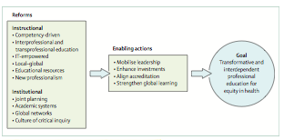
Recommendations for reforms
and enabling actions

Slide 17
